Slide 1
How to teach carers/families to help manage breakthrough symptoms safely using subcutaneous medicines
Presented by:
[Insert your name here]
[Insert your organisation here]
caring@home is funded by the Australian Government and led by the Brisbane South Palliative Care Collaborative
Notes:
Facilitator notes
Key points
It is recommended that before you run this session with your team that you have:
Introduced the caring@home resources. If time allows, you may be able to run a separate session using the PowerPoint Introducing the caring@home resources. This is available on the website
Completed the online modules on the caring@home website
Watched the carer/family training videos
Obtained and familiarised yourself with all the resources for carers/families and health professionals and how to access them

Slide 2
Learning outcomes
Prepare for training session/s with a carer/family
Use the caring@home resources to teach the carer/family how to help manage breakthrough symptoms safely using subcutaneous medicines
Observe and assess a carer’s competency to help manage subcutaneous medicines for breakthrough symptoms safely

Slide 3
Please note…
For patient safety, clinical services should only teach carers/ families to use subcutaneous medicines if they can provide a 24-hour phone number, to provide appropriate clinical advice about managing subcutaneous medicines (1, 2).
Research shows that with appropriate training and high-quality resources, carers/families can safely manage subcutaneous medicines at home (3, 4)
Teaching carers/families about how to manage subcutaneous medicines may require more than one training session.
Notes:
Facilitator notes
Key points
Carers/families consistently indicate that having a telephone number they can call at any time for clinical advice is essential to help give them confidence to manage subcutaneous medicines.

Slide 4
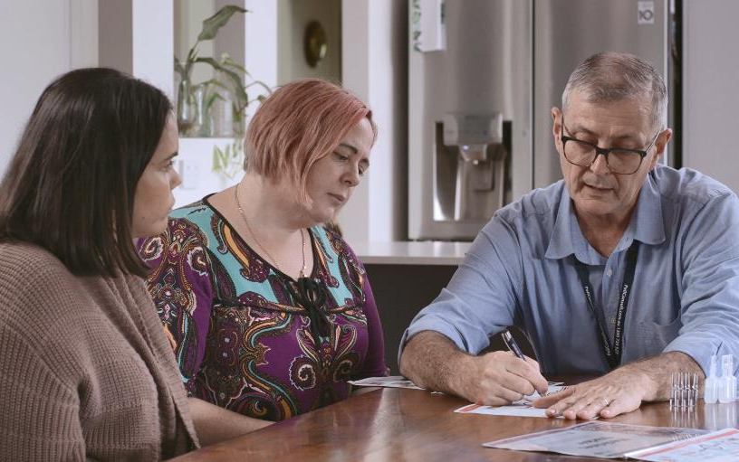
Checking carer understanding
It is important to check carer understanding. Good strategies include:
Teach-back strategy
The ask-tell-ask method
Teach to goal (5)
Notes:
Facilitator notes
Key points
Explain to participants why it is so important to check that the carer/family understands what they need to do
Explain to the participants the following 3 strategies to check understanding:
Teach-back strategy where the carer is asked to explain in their own words what has been explained
The ask-tell-ask method is a cycle of back-and-forth information and response
Teach to goal is a strategy where the carer is asked to demonstrate doing tasks that has been demonstrated to them (5).
Encourage participants to encourage the carer/family to ask questions at any time.

Slide 5
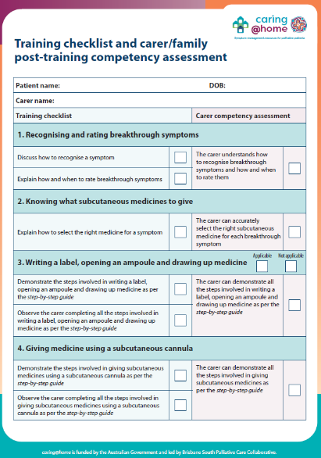
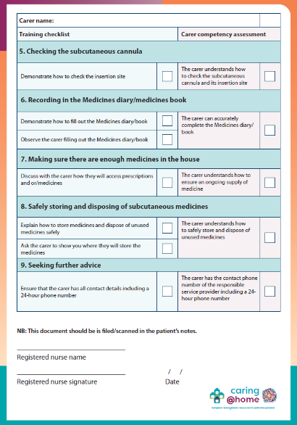
Checking carer competency
Training checklist and carer/family post-training competency assessment
Notes:
Facilitator notes
Key points
Explain how the carer/family competency checklist can be used and completed whilst checking understanding
Inform participants about where to file the completed competency assessment form.

Slide 6
Elements of the carer/family training session/s
Recognising and rating breakthrough symptoms
Knowing what medicines to give
Writing a label, opening an ampoule and drawing up medicine
Giving medicine using a subcutaneous cannula
Checking the subcutaneous cannula
Recording in the medicines diary/book
Making sure there are enough medicines in the house
Safely storing and disposing of unwanted subcutaneous medicines
Seeking further advice.
Notes:
Facilitator notes
Key points
Explain the key elements to the one-on-one carer/family training session/s varying it depending on the clinical practice in your service e.g. no need to teach carers/families to write a label, open an ampoule and draw up medicine if in your service the nurse routinely draws up medicine.
Notes
The elements of the one-on-one training are clearly outlined in the Training checklist and carer/family post-training competency assessment. This form has a dual purpose:
A teaching tool for RNs to guide one-on-one training session/s with a carer/family
Prompts for the RN to ensure that the carer is competent with each element. The form may be stored in the patient’s clinical notes.

Slide 7
Recognising and rating breakthrough symptoms
Community Palliative Care Resources
 | Read the relevant tip sheet Example: Help with feeling sick and/or vomiting
 | Refer to the back page of the Medicines diary
 | Watch video: How to help manage symptoms with medicines at home
Aboriginal and Torres Strait Islander families
 | Read the relevant tip sheet; Example: Help with feeling sick in the gut
 | Refer to the Medicines book. See back page: How worrying is it?
 | Watch video (including with voiceover): Help manage symptoms at home
Standard and translated
 | Read page 9, 10, 22, 23 and 24 of A practical handbook for carers; Translated handbook
 | Refer to the Medicines diary; Translated diary
 | Watch video: Recognising and rating breakthrough symptoms; Subtitled video
Notes:
Facilitator notes
Key points
Inform participants that these are the relevant carer/family resources to use when teaching about this topic
Discuss the following key points for participants to explain in the carer/family training session/s:
What the terms ‘symptom’ and ‘breakthrough symptom’ mean
Information about common breakthrough symptoms i.e. they may or may not occur; they may require an extra dose of medicine; they may be harder to treat if allowed to get worse; more than one may occur at the same time
The best way to determine the level of distress that a symptom may be causing a person is to ask them, however if this is not possible let the carer/family know that they should trust their own judgement and may need to rely on other signs
If the person being cared for is experiencing a symptom not listed in the caring@home resources, the carer/family should be educated to notice if that symptom is worsening
If a new symptom develops, the carer/family should tell the nurse straight away
Rating a symptom is a guide and is best done at two different times; ‘before’ and ‘about 20 minutes after’ the subcutaneous medicine is given; it’s the change in these ratings that informs if the medicine is effective
The carer/family is likely to know the person that they are caring for better than any health care professional therefore should trust their own judgement.

Slide 8
Recognising and rating breakthrough symptoms
CLINICAL NOTES
How do you know what are common breakthrough symptoms?
Why are symptom rating scales used?
Notes:
Facilitator notes
Key points Breakthrough symptoms
Reinforce that there are well-known common breakthrough symptoms occurring at end of life and by teaching about these common symptoms, the carer/family can be prepared
If appropriate, discuss the common breakthrough symptoms.
Symptom rating scale
The purpose of the numerical/facial rating scale is to assess the level of distress caused by a symptom
The patient’s opinion of the severity of the symptom is considered to be best practice (‘gold’ standard). If the person is no longer able to communicate, a carer/family may need to rely on their knowledge of the person to rate the symptoms on their behalf
Your service may use a slightly different rating scale. If that is the case, then you will need to explain it to the carer/family (6).
Activity
It is recommended that you work through each clinical note and ask for participant comments/questions as you discuss.

Slide 9
Knowing what subcutaneous medicines to give
Community Palliative Care Resources
 | Read the relevant tip sheet Example: Help with feeling sick and/or vomiting
 | Refer to the Wall chart
 | Watch video: How to help manage symptoms with medicines at home
Aboriginal and Torres Strait Islander families
 | Read the relevant tip sheet. Example: Help with feeling sick in the gut
 | Refer to the Wall chart
 | Watch video: Help manage symptoms at home
Standard and translated
 | Read page 12 and 25 of A practical handbook for carers; Translated handbook
 | Refer to the Fridge chart; Translated fridge chart
 | Watch video: Subcutaneous medicines; Subtitled video
Notes:
Facilitator notes
Key points
Inform participants that these are relevant carer/family resources to use when teaching about this topic
Discuss the following key points for participants to explain in the carer/family training session/s:
The doctor/nurse practitioner will prescribe medicines in anticipation of a symptom appearing (often known as anticipatory prescribing or just-in-case prescribing)
The reason for the use and the possible side effects of each of the prescribed subcutaneous medicines
Medicines mainly come from the carer’s community pharmacy, but some may be dispensed through the hospital depending on the service
Subcutaneous medicine is drawn up in a syringe from an ampoule
Who will draw up the medicine – whether the nurse will do this or whether the carer will be taught to do this
For safety, every syringe must have a label on it
The label must have the name of the medicine, the symptom, the dose of the medicine, the initials of the person preparing the medicine and the date of preparation
Reading the label before giving the medicine is essential
The colour-coded labelling system, including the fridge chart, can be used as an extra safety check.
Explain that participants need to write each prescribed medicine (in correct colour-coded area) and the corresponding symptom on the fridge/wall chart.

Slide 10
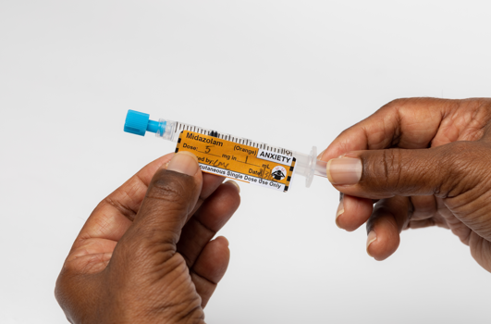
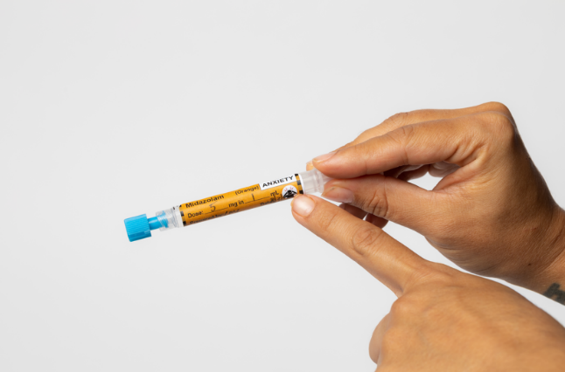
Knowing what subcutaneous medicines to give
CLINICAL NOTES
Why is anticipatory prescribing important?
How to ensure the carer selects the correct medicine?
Notes:
Facilitator notes
Key points Anticipatory prescribing
Anticipatory prescribing can be defined as the proactive prescribing of medicines that may be required to control common symptoms in the last days of life
Anticipatory prescribing is best practice for providing high-quality end-of-life care. It can help to avoid a crisis. It ensures medicines that are likely to be needed are already available in the home (7).
Selecting the correct medicine
Explain that every prepared medicine syringe must be correctly labelled. It is essential to carefully read the medicine syringe label to ensure that the right medicine has been selected for a particular breakthrough symptom
The colour-coded labelling system, syringe labels and fridge/wall chart, are extra safety checks to support best practice of checking and reading the label on the syringe.
Activity
It is recommended that you work through each clinical note and ask for participant comments/questions as you discuss.

Slide 11
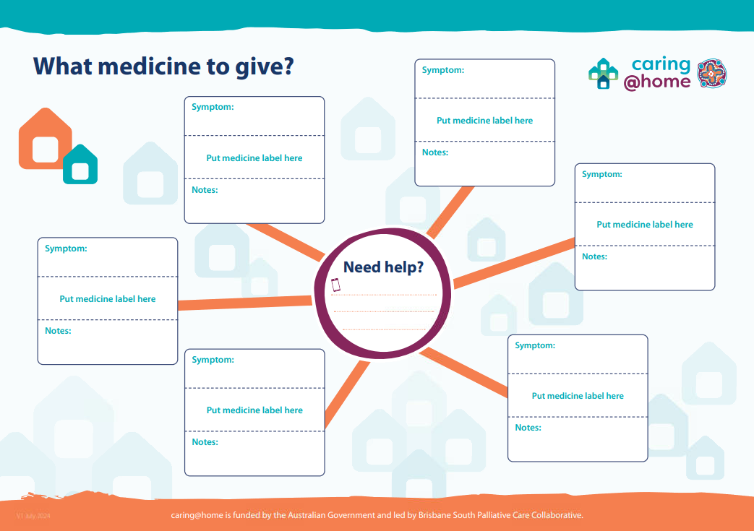
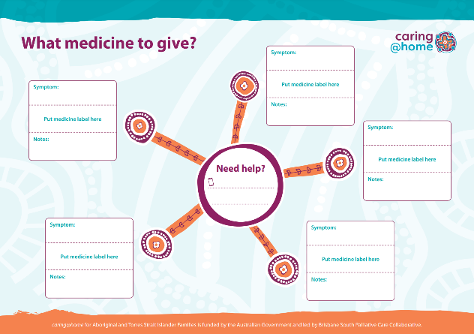
Knowing what subcutaneous medicines to give
CLINICAL NOTES
Where does the colour-coded labelling system originate from?
Why are blank syringe labels included in the caring@home resources?
Notes:
Facilitator notes
Key points Colour-coded labelling system
The colours in this system are adapted from the National Standards developed by the Australian Commission on Safety and Quality in Health Care (8).
Blank syringe labels
Blank labels are supplied for when a drug is prescribed that is not included in one of the pre-printed labels
Labels for specialist palliative care services
There are additional labels for Specialist Palliative Care Services which can be requested from caring@home.
Activity
It is recommended that you work through each clinical note and ask for participant comments/questions as you discuss.

Slide 12
Writing a label, opening an ampoule and drawing up medicine
Community Palliative Care Resources
 | Refer to the step-by-step guide How to put the medicine in the syringe
 | Watch video: How to put medicine in the syringe
Aboriginal and Torres Strait Islander families
 | Read Put medicine in the syringe
 | Watch video: How to put medicine in a syringe
Standard and translated
 | Read: Writing a label, opening an ampoule and drawing up medicine: A step-by-step guide; Translated step-by-step guide
 | Watch video: Writing a label, opening an ampoule and drawing up medicine; Subtitled video
Notes:
Facilitator notes
Key points
Inform participants that these are relevant carer/family resources to use when teaching about this topic
Discuss the following key points for participants to explain in the carer/family training session/s:
The location of the doctor’s/nurse practitioner’s written medical order for each PRN medicine and the breakthrough symptom that it is used to treat
How to calculate the dose of medicine to be drawn up into the syringe, if the carer is to draw up medicine
Each step in the step-by-step guide.

Slide 13
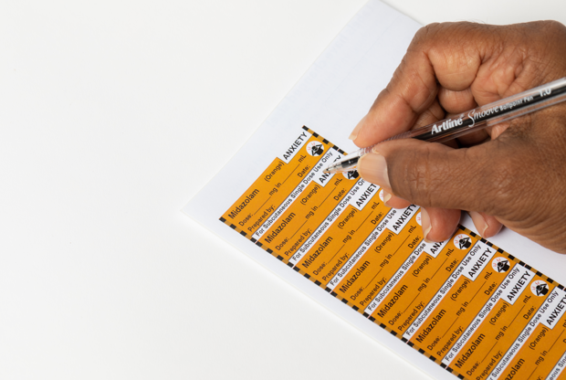
Writing a label, opening an ampoule and drawing up medicine
CLINICAL NOTES
Calculating how much medicine to draw up in the syringe
Labelling a syringe
Notes:
Facilitator notes
Key points Calculating the dose
If the carer/family is to draw up medicine, you will need to show them how to draw up the correct dose as per the prescriber’s order
Calculate the volume of the medicine to be drawn into the syringe based on the dose in the order and the concentration of the medicine in the ampoule.
Labelling a syringe
All syringes must be correctly labelled (8). Colour-coded labels included in the caring@home resources are pre-printed with the name of the medicine, and the symptom that the medicine is used to treat
In the case of colour-blindness, the coloured labels also have the colour printed on them. You or the carer (depending on who is drawing up the medicine) must write the dose, the date the dose is prepared, and the initials of the person drawing up the medicine
The label states that the syringe is for subcutaneous single dose use only. Explain that only one dose of the medicine will be contained in each syringe. The dose of the medicine in the syringe will match the dose written on the prescriber’s order
If a carer cannot calculate the volume of subcutaneous medicine to draw up into the syringe, then they cannot be assessed as competent to do this task.
Activity
It is recommended that you work through each clinical note and ask for participant comments/questions as you discuss.

Slide 14
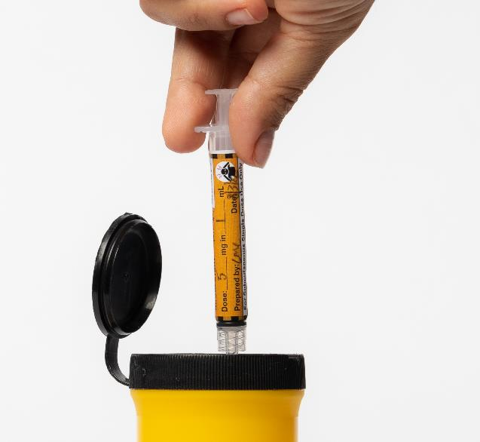
Writing a label, opening an ampoule and drawing up medicine
CLINICAL NOTES
If the nurse draws up the medicine
Opening an ampoule
Disposing of sharps container
Notes:
Facilitator notes
Key points If the nurse draws up the medicine
Depending on your work-place policies and procedures, you may draw up syringes and label them to store in a container in the fridge. If this is the case, you may choose to skip this element of the training entirely or go through it briefly (or at a later date) so that the carer/family could do the steps if required in an emergency e.g. on the weekend, overnight.
Opening an ampoule
Your workplace may use an ampoule opener. If that is the case, teach the carer/family how to use it. Some may prefer to use an ampoule opener. You can advise that these are available at the local chemist
There is also an easy way to teach carers to open a glass ampoule using an empty syringe as shown on this video: https://vimeo.com/387848388/14e8a79140.
Sharps container
A sharps container should be supplied. Explain how to dispose of sharps container according to your workplace policies and procedures.
Activity
It is recommended that you work through each clinical note and ask for participant comments/questions as you discuss.

Slide 15
Giving medicine using a subcutaneous cannula
Community Palliative Care Resources
 | Refer to the step-by-step guide How to give medicine under the skin
 | Refer to the Medicines diary; Refer to the Wall chart
 | Watch video: How to give medicine under the skin
Aboriginal and Torres Strait Islander families
 | Read Give the medicine under the skin
 | Refer to the Wall chart
 | Watch video: How to give medicine under the skin
Standard and translated
 | Read Giving a medicine using a subcutaneous cannula: A step-by-step guide; Translated step-by-step guide
 | Refer to the Medicines diary; Translated diary
 | Refer to the Fridge chart; Translated fridge chart
 | Watch video: Giving medicine using a subcutaneous cannula; Subtitled video
Notes:
Facilitator notes
Key points
Inform participants that these are relevant carer/family resources to use when teaching about this topic
Discuss the following key points for participants to explain in the carer/family training session/s:
The need for two subcutaneous cannulas
The aseptic technique carers will be using
Each step in the step-by-step guide.
Notes
If the person being cared for needs medicine during the training session, this may be an appropriate time to teach the carer in a supervised way. If not, the practice demonstration kit may be used as a teaching tool by you and for the carer to practice on after the training session.

Slide 16
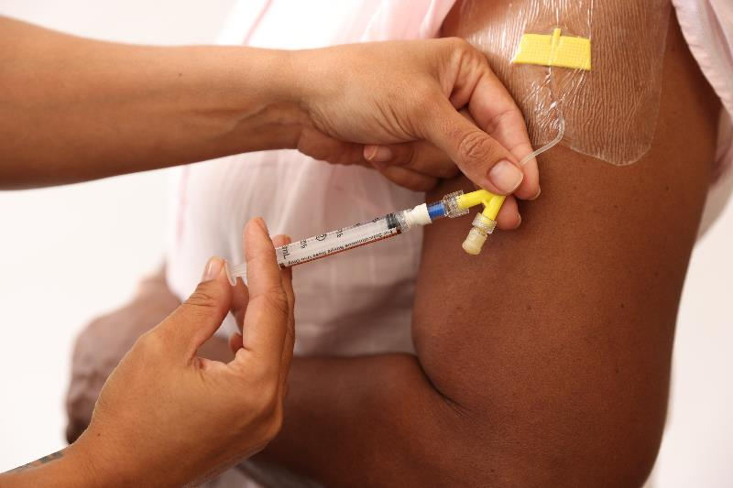
Giving medicine using a subcutaneous cannula
CLINICAL NOTES
Why insert two subcutaneous cannulas?
Why use a needleless technique?
Why flush the cannula?
Why flush with sodium chloride 0.9%?
Notes:
Facilitator notes
Key points Inserting two subcutaneous cannulas
Inserting two subcutaneous cannulas in considered best practice in case the first cannula becomes blocked (9). The insertion of a second cannula ensures that the person can still have timely access to medicines, even when the nurse is not immediately available to replace the blocked cannula. If the patient has a continuous subcutaneous infusion via one of the cannulas, breakthrough medicines should be administered via the second subcutaneous cannula rather than using the second arm of the cannula connected to the infusion device.
Using a needleless technique
To maximise patient, carer and staff safety by reducing the possibility of needle stick injury, it is considered best practice to use a needleless technique when giving subcutaneous medicines (10).
Flushing the cannula
It is important to flush the subcutaneous cannula following a dose of subcutaneous medicine so that the complete dose of medicine is administered. If multiple medicines are given at the same time, it is only necessary to flush once – after the last dose (9).
Flushing with sodium chloride
To maintain site longevity, best practice is to use sodium chloride 0.9% for the flush following delivery of medicine. The recommended volume for the flush is 0.5mL (11).
Activity
It is recommended that you work through each clinical note and ask for participant comments/questions as you discuss.

Slide 17
Checking the subcutaneous cannula
Community Palliative Care Resources
 | Refer to step 1 of step-by-step guide How to give medicine under the skin
Aboriginal and Torres Strait Islander families
 | Refer to step 1 of the step-by-step guide Give the medicine under the skin
Standard and translated
 | Read page 18 and 22 of A practical handbook for carers; Translated handbook
Notes:
Facilitator notes
Key points
Inform participants that these are relevant carer/family resources to use when teaching about this topic
Discuss the following key points for participants to explain in the carer/family training session/s:
A subcutaneous cannula – what it looks like, how it works and its different parts
What to look for when checking the insertion site.

Slide 18
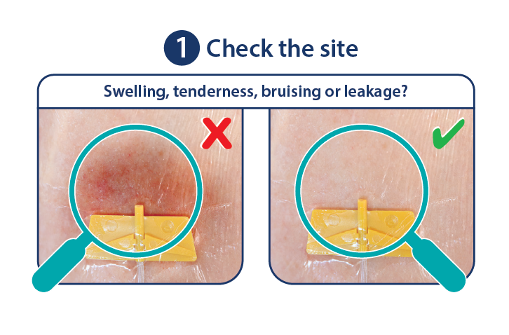
Checking the subcutaneous cannula
CLINICAL NOTES
Explaining what an inflamed insertion site looks like
Community Palliative Care Resources Box
Palliative Care Clinic Box
Notes:
Facilitator notes
Key points
Explaining what an inflamed insertion site looks like
Carers/families may not necessarily understand how an inflamed site appears so pay attention to giving a thorough explanation. You may like to use an image to illustrate your explanation.
Inform the carer that a small lump sometimes appears after giving the subcutaneous medicine and this will soon disappear.

Slide 19
Recording in the Medicines diary/book
Community Palliative Care Resources
 | Refer to the Medicines diary
 | Watch video: How to manage symptoms with medicines at home
Aboriginal and Torres Strait Islander families
 | Refer to the Medicines book
 | Watch video: Help manage symptoms at home
Standard and translated
 | Read page 18 of A practical handbook for carers; Translated handbook
 | Refer to the Medicines diary; Translated diary
 | Watch video: Subcutaneous medicines; Subtitled video
Notes:
Facilitator notes
Key points
Inform participants that these are relevant carer/family resources to use when teaching about this topic
Discuss the following key points for participants to explain in the carer/family training session/s:
The importance of writing in the diary each time medicine is given including that this allows the carer and the health professional to keep track of the amount of medicine used and the nurse or doctor can use the diary to assess if the medicines need to be changed.
Notes
During the training, the carer can complete an entry in the diary. This can be written as “example only” if needed.

Slide 20
Making sure there are enough medicines in the home
Community Palliative Care Resources
 | Read factsheet Making sure there are enough medicines in the home
Aboriginal and Torres Strait Islander families
 | Explain to carer/family how to ensure there is enough medicines in the house.
Standard and translated
 | Read page 19 of A practical handbook for carers; Translated handbook
Notes:
Facilitator notes
Key points
Inform participants that these are relevant carer/family resources to use when teaching about this topic
Discuss the following key points for participants to explain in the carer/family training session/s:
Prescriptions are required for all subcutaneous medicines
It is recommended that enough medicine for at least three days is always available in the home
The carer/family needs to check the amount of medicine every day and let prescriber and pharmacist know if the stocks are getting low
It may take a couple of days for medicines to arrive at the chemist (especially in rural or remote locations) and carer/family will need to consider weekends and public holidays
If it is difficult for the carer/family to get to the chemist to pick up the medicines, contact the pharmacist and ask if they can be home-delivered
Whether the chemist has an after-hours service and how to access it if needed.

Slide 21
Safely storing and disposing of subcutaneous medicines
Community Palliative Care Resources
 | Read Storing your palliative care medicines safely/Disposing of your palliative care medicines safely
Aboriginal and Torres Strait Islander families
 | Explain to carer/family how to safely store and dispose of medicines.
Standard and translated
 | Read page 20 of A practical handbook for carers; Translated handbook
Notes:
Facilitator notes
Key points
Inform participants that these are relevant carer/family resources to use when teaching about this topic
Discuss the following key points for participants to explain in the carer/family training session/s:
Where medicines will be stored in the home
The return all unused medicines to the chemist, or other appropriate place, in a timely fashion
Disposal of the sharps container (according to the organisation’s workplace policies and procedures).

Slide 22
Seeking further advice
Write the 24-hour contact number on the fridge/wall chart
Ensure the carer can show you where to find the 24-hour contact number
Write number here
Write number here
Notes:
Facilitator notes
Key points
Discuss the following key points for participants to explain in the carer/family training session/s:
This refers to the service’s 24-hour on-call number that will be given to carers/families.
Notes:
Participants should write all contact details, including the 24-hour number, on the fridge chart in the home.
Carer competency to show where the 24hour number is written should be assessed.

Slide 23
Please note…
Ask the carer/family if they have any questions
Remind the carer/family to call for advice at any time
Check carer competency and complete the Training checklist and carer/family post-training competency assessment.

Slide 24
References
Shepperd S, Gonçalves-Bradley DC, Straus S, Wee B. Hospital at home: home-based end-of-life care. Cochrane Database Syst. Rev. 2016; 2: 1465-1858. Available from: https://doi.org/10.1002/14651858.CD009231.pub2. [Accessed 6 December 2018].
Wilson E, Caswell G, Turner N, Pollock K. Managing medicines for patients dying at home: A review of family caregivers’ experiences. J Pain Symptom Manage. 2018; 56(6):962-974. Available from: https://doi.org/10.1016/j.jpainsymman.2018.08.019. [Accessed 6 December 2018].
Israel F, Reymond L, Slade G, Menadue S, Charles MA. Lay caregivers’ perspectives on injecting subcutaneous medications at home. Int J Palliat Nurs. 2008; 14(8): 390-395. Available from: https://doi.org/10.12968/ijpn.2008.14.8.30774. [Accessed 6 December 2018].
Healy S, Israel F, Charles M, Reymond L. Laycarers can confidently prepare and administer subcutaneous injections for palliative care patients at home: A randomized controlled trial. Palliat Med. 2018; 32(7): 1208-1215. Available from: https://doi.org/10.1177%2F0269216318773878. [Accessed 6 December 2018].

Slide 25
Baker DW, DeWalt DA, Schillinger D et.al. “Teach to goal”: theory and design principles of an intervention to improve heart failure self management skills of patients with low health literacy. J Health Comm. 2011; 16 Suppl(3):73-88. Available from: https://doi.org/10.1080/10810730.2011.604379. [Accessed 3 January 2019].
Chang VT, Hwang SS, Feurerman M. Validation of the Edmonton Symptom Assessment. Cancer. 2000 May 1; 88(9):2164-71. Available from: https://www.ncbi.nlm.nih.gov/pubmed/10813730. [Accessed 3 January 2019].
Palliative Care Expert Group. Therapeutic Guidelines: Palliative Care Version 4. Melbourne: Therapeutic Guidelines Ltd ; 2016.
Australian Commission on Safety and Quality in Health Care. National Standard for User-applied Labelling of Injectable Medicines, Fluids and Lines. Sydney: ACSQHC, 2015. Available from: https://www.safetyandquality.gov.au/publications/national-standard-for-user-applied-labelling/. [Accessed 3 January 2019].
Healy S, Israel F, Charles M, Reymond L. Caring Safely at Home Project Final Report 2012. Brisbane: Brisbane South Palliative Care Collaborative. Available from: https://www.caresearch.com.au/caresearch/Portals/0/Documents/WhatisPalliativeCare/NationalProgram/PCForPeopleAtHome/Final_SummaryRreport_June2011_CSAH.pdf. [Accessed 3 January 2019].

Slide 26
Kumar RB, Rahman ZU. Needle free injection systems. Int J Pharm Sci Res. 2013; 4(1):132-147. Available from: http://ijpsr.com/bft-article/needle-free-injection-systems/?view=fulltext. [Accessed 3 January 2019].
Flowers C, McLeod F. Diluent choice for subcutaneous infusion: a survey of the literature and Australian practice. Int J Palliat Nurs. 2005; 11(2): 54-60. Available from: https://doi.org/10.12968/ijpn.2005.11.2.17670. [Accessed 3 January 2019].

Slide 27
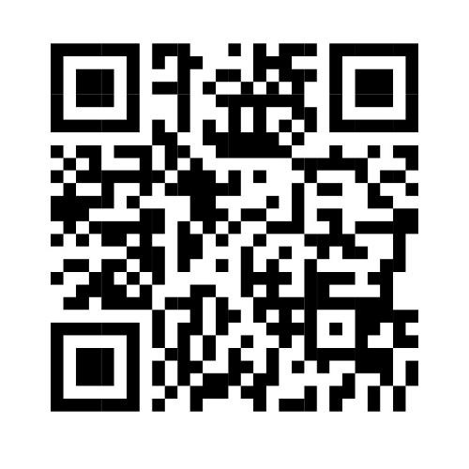
Contact us
1300 600 007
caringathomeproject.com.au
caringathome@health.qld.gov.au

