Slide 1

Introducing caring@home resources
Presented by:
[Insert your name here]
[Insert your organisation here]
caring@home is funded by the Australian Government and led by the Brisbane South Palliative Care Collaborative
Notes:
Notes: ​
It is recommended that before you run this session with your team that you have: ​
Completed the online modules on the caring@home website​
Watched the short training videos​
Obtained and familiarised yourself with all the resources and how to access them​
Ensured that you have internet availability to demonstrate how to access the online modules for registered nurses.​
The resources include: ​
The caring@home package for carers (the package can be either ordered or most components downloaded from the caring@home website)
The Palliative Care Clinic Box ​(the package can be either ordered or most components downloaded from the caring@home website)
‘Guidelines for the handling of palliative care medicines in community services’​
The ‘Example policy and procedures: Supporting carers to help manage breakthrough symptoms safely using subcutaneous medicines in the home’​
The ‘Prompts for End-of-Life Planning (PELP) Framework
The ‘National Core Community Palliative Care Medicines List’ ​
The palliMEDS app downloaded onto your phone

Slide 2

Presentation overview
caring@home project background
What resources are available, and for whom?
How will the resources help?

Slide 3
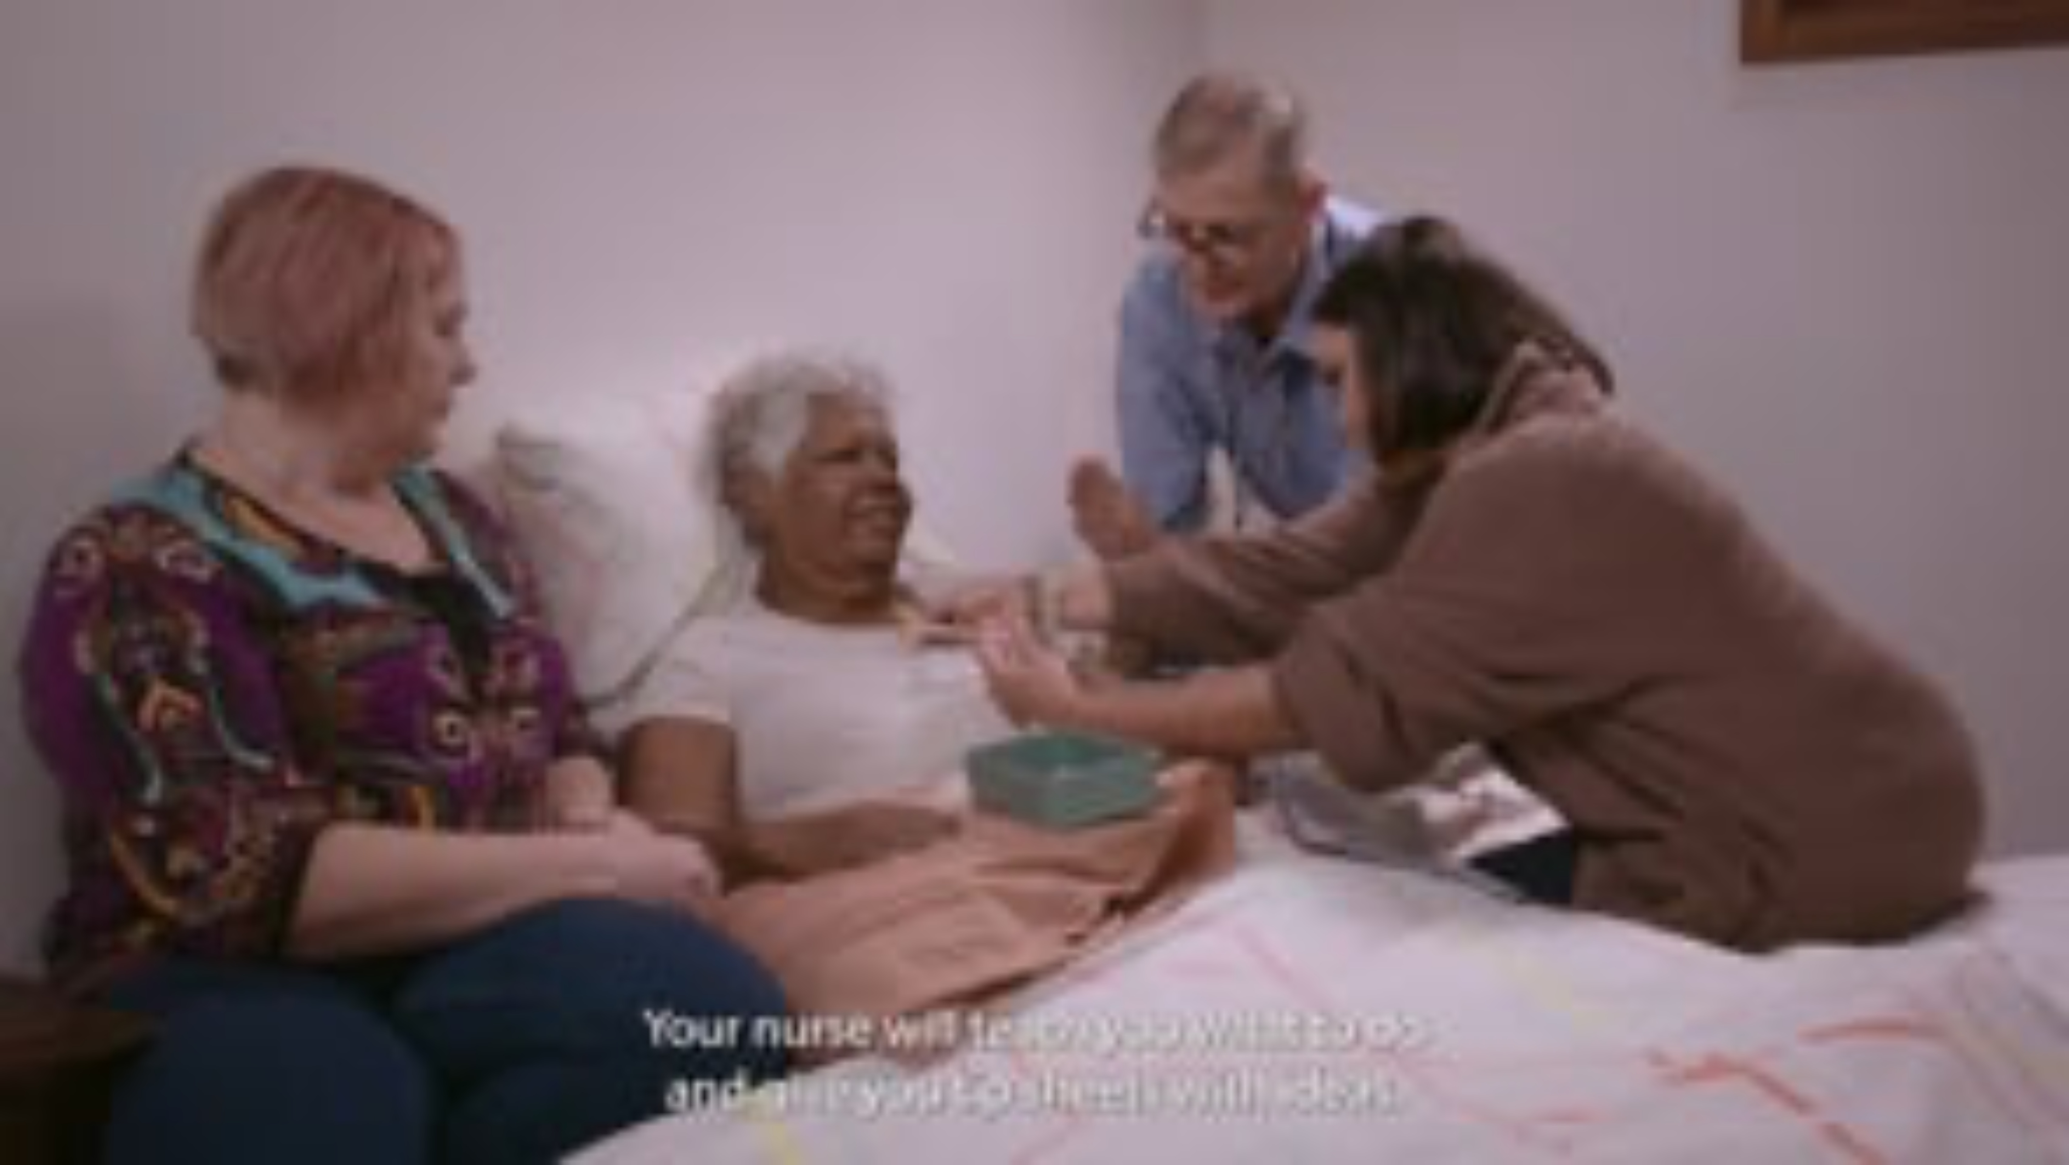
Why is caring@home important?
Notes:
Facilitator notes:
If you have the time in your session, you may wish to show this video.
The video is 2:35 minutes duration.
The link for the video is: https://vimeo.com/729856699/f25645966d

Slide 4
What does the evidence teach us?
Many people wish to be cared for and die at home ^{(1, 2)}
Waiting for a health professional to give breakthrough symptom medicines increases patient and carer distress ^{(1, 2)}
Poor symptom control often results in unwanted admissions to an inpatient unit ⁽³⁾
Carers feel empowered when taught to give subcutaneous
medicines using high quality resources ^{(4, 5, 6, 7, 8)}.

Slide 5
Carers' comments
“We knew when the pain hit, we were able to do something to try to relieve it immediately without having to sit waiting, powerless, for someone to come and do it. I believe it gave us confidence to keep him at home to the very end.” ⁽⁸⁾
“These resources taught me and my mob how to yarn and feel good [about] giving medicine. I liked the one about worry because Aunty felt exactly like the picture.”​ - First Nations family in WA
“[caring@home resources] have helped us learn about how to give medicine at home when my loved one is experiencing pain…we now feel more comfortable giving medication to Uncle.” ​- First Nations family in VIC
“I really like the art with the pretty colours. I know it was made just for us mob. [I feel] safe now with these [resources].” – First Nations family in ACT

Slide 6
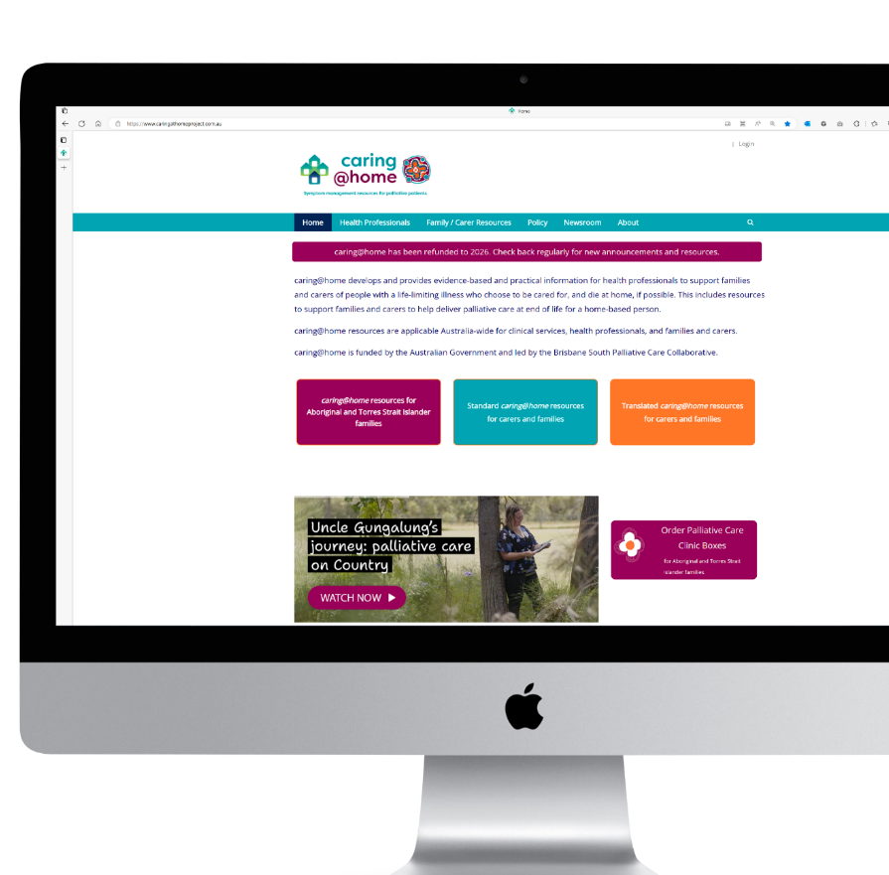
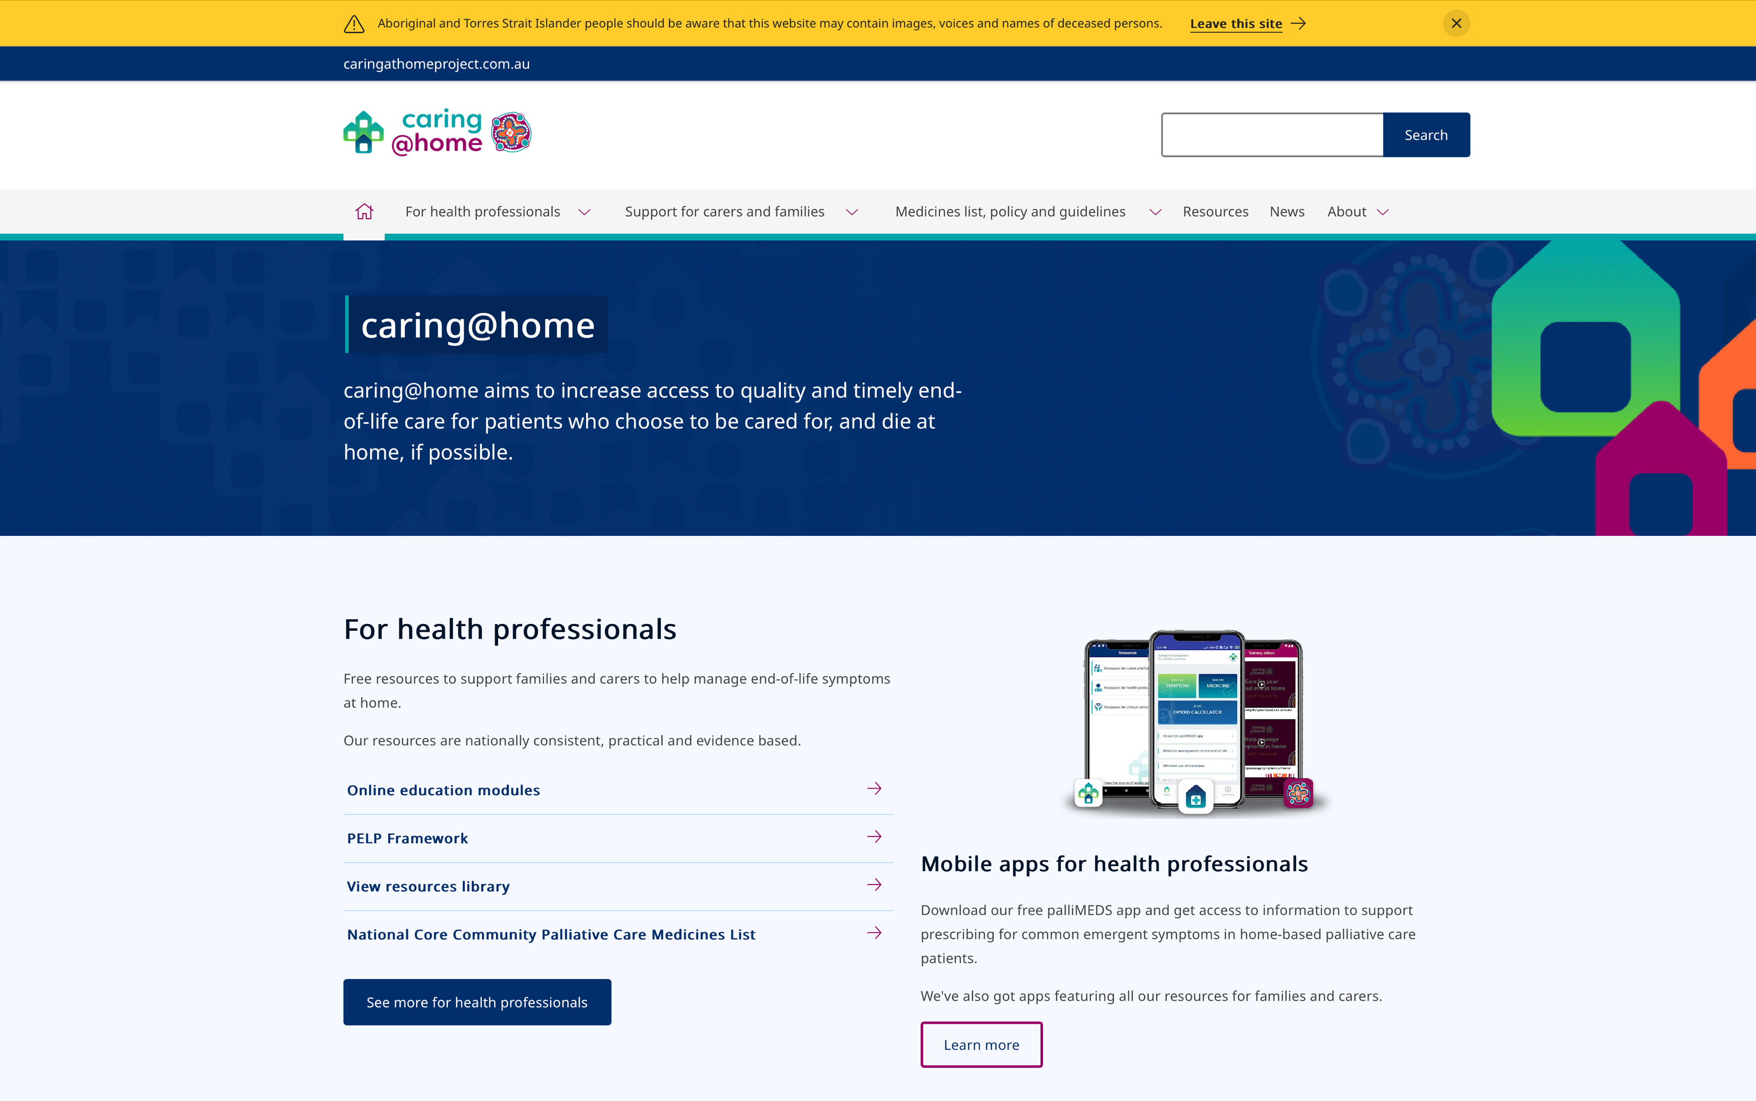

caring@home resources
Suite of resources available for:
Clinical services
Health professionals
Families/carers
caringathomeproject.com.au
Notes:
Facilitator notes:
The resources are targeted at three levels:
Clinical services
Health professionals
Carers/families

Slide 7

Please note…
For patient safety, clinical services should only teach carers/ families to use subcutaneous medicines if they can provide a 24-hour phone number, to provide appropriate clinical advice about managing subcutaneous medicines (1, 2).
Notes:
Facilitator notes:
Carers/families consistently indicate that having a telephone number that they can call at any time for clinical advice is essential to help give them confidence to manage subcutaneous medicines.

Slide 8
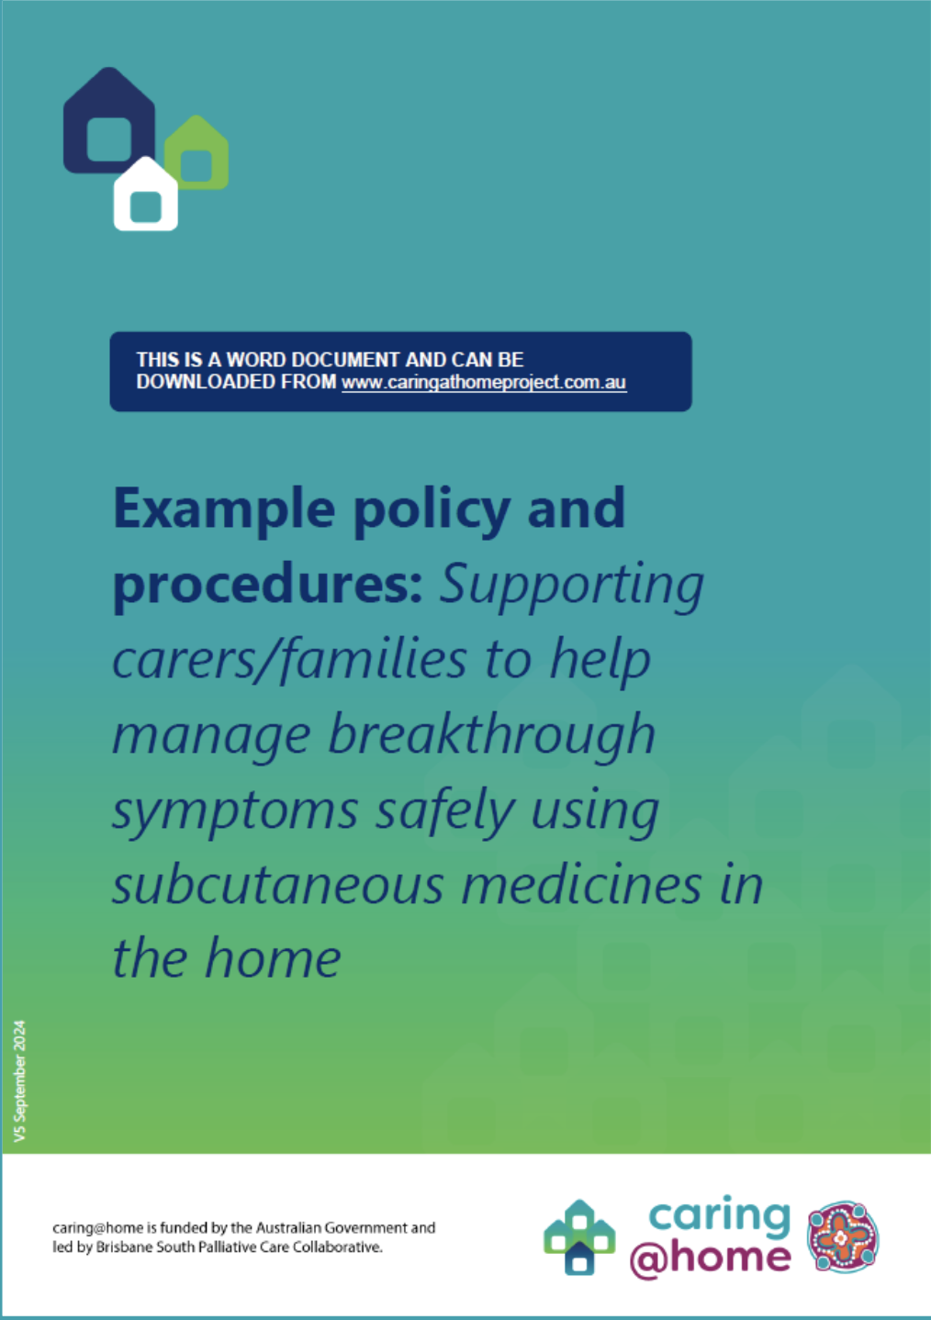
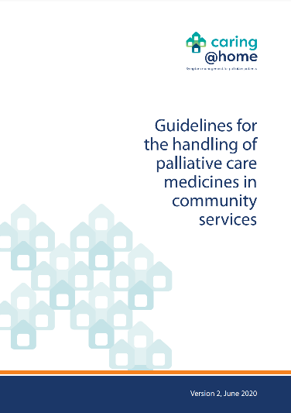
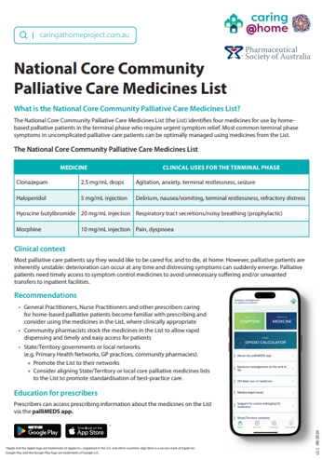




Resources for clinical services
Example policy and procedures:
Supporting carers to help manage breakthrough symptoms safely using subcutaneous medicines in the home
Guidelines for the handling of palliative care medicines in community services
National Core Community Palliative Care Medicines List
caringathomeproject.com.au
Notes:
Facilitator notes:
The ‘Example policy and procedures: Supporting carers to help manage breakthrough symptoms safely using subcutaneous medicines in the home (Version 5)’
This document may be used by clinical services to develop and/or review relevant documentation within their own policies and procedures framework.
2. The ‘Guidelines for the handling of palliative care medicines in community services (Version 2)’ were developed by the National Prescribing Service for the caring@home project.
These guidelines are important as they can be used by community service providers to inform the development of detailed protocols and procedures tailored to the requirements of individual services.
3. The ‘National Core Community Palliative Care Medicines List’
This document identifies four medicines for use by home-based palliative patients in the terminal phase who require urgent symptom relief. Most common terminal phase symptoms in uncomplicated palliative care patients can be optimally managed using medicines from the List.

Slide 9
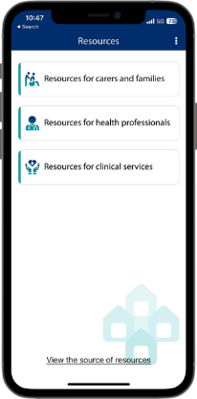
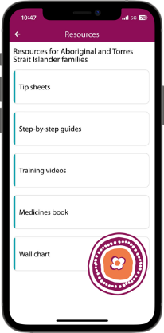
Resources for health professionals
Online education modules
palliMEDS app
Prompts for End-of-Life Planning (PELP) Framework
Introducing caring@home resources PowerPoint
Conducting education for a carer PowerPoint
A guide for health professionals providing palliative care to Aboriginal and Torres Strait Islander patients and their carers/families
caring@home app
caring@home Indigenous app
Notes:
Facilitator notes:
These resources are available on the website: https://www.caringathomeproject.com.au

Slide 10
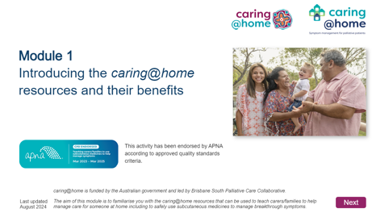
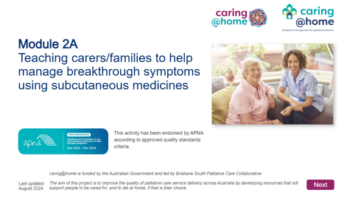
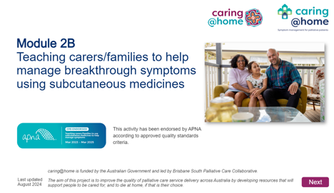
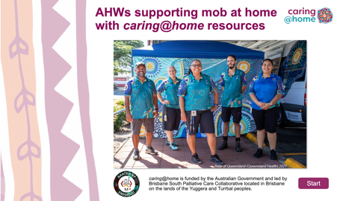
Online education modules
FOR HEALTH PROFESSIONALS
FOR ABORIGINAL HEALTH WORKERS
caringathomeproject.com.au
Notes:
Notes:
Online education modules for health professionals
It is recommended that health professionals complete all the online modules prior to using the caring@home resources to teach carers/families to manage subcutaneous medicines at home.
Module 1 takes 20 minutes to complete.
This module aims to educate health professionals about the caring@home resources.
Module 2 takes 40 minutes and is presented in two parts.
This modules aims to educate health professionals about how to use the caring@home resources to teach carers to help manage breakthrough symptoms safely using subcutaneous medicines.
A certificate of learning can be printed for module 1 and each part of module 2.
Online education module for Aboriginal Health Workers
This module aims to educate AHWs about the caring@home resources.
This module takes 20 minutes to complete.
A certificate of learning can be generated on completion of the module.
These modules can be accessed through the caring@home website: https://www.caringathomeproject.com.au/for-health-professionals/online-education-modules

Slide 11
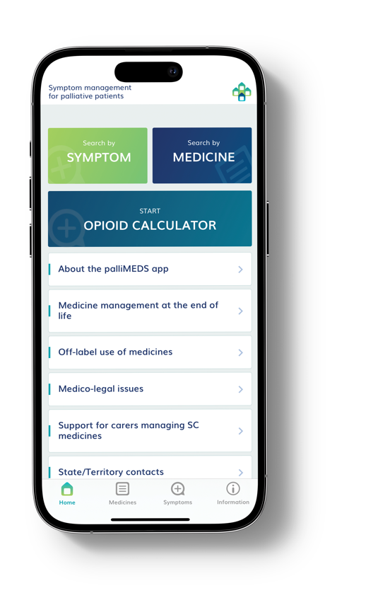

Medicines
palliMEDs app
National Core Community Palliative Care Medicines List
Notes:
Notes: ​
The palliMEDS app is available to download onto your phone.
This app explains the use of the eight medicines that have been endorsed for end-of-life care by the Australian and New Zealand Society of Palliative Medicine
2. The ‘National Core Community Palliative Care Medicines List’
This List outlines four medicines for use by home-based palliative patients in the terminal phase who require urgent symptom relief. The Australian Government Department of Health and Aged Care supported caring@home to develop a core medicines list applicable across all Australian States and Territories.

Slide 12
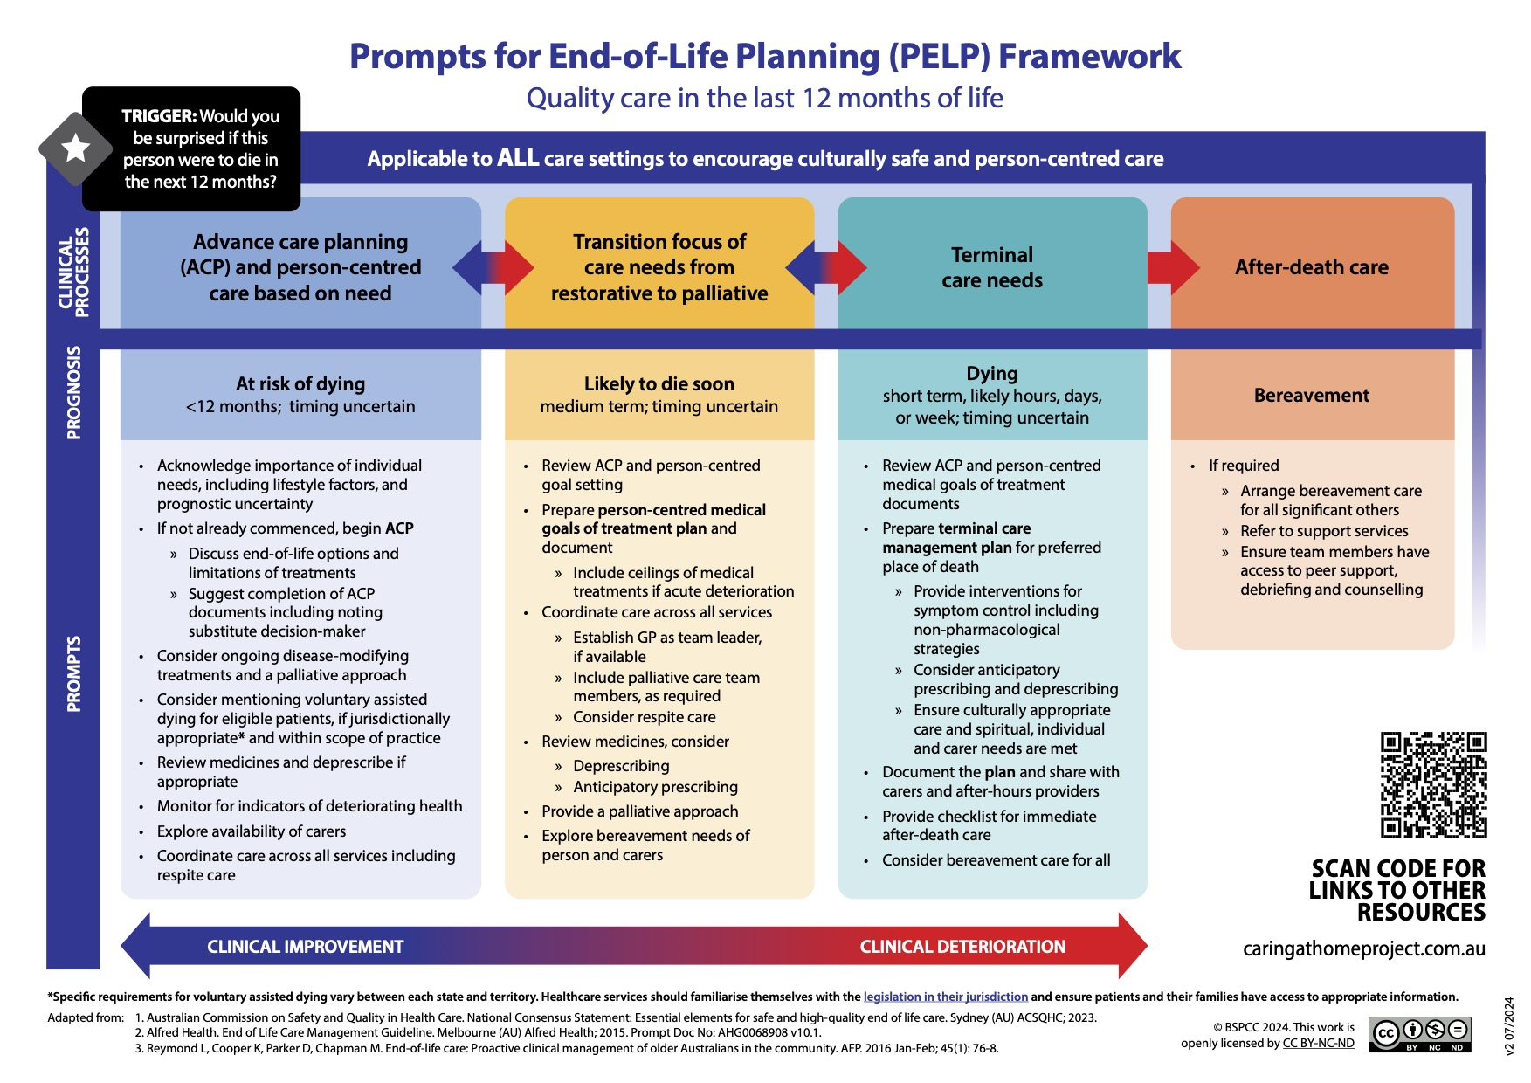
PELP
Framework
Notes:
Facilitator notes:
The Prompts for End-of-Life Planning (PELP) Framework contains prompts that support:
Identification of patients suitable for a palliative approach to care
Identification of four clinical end-of-life processes

Slide 13
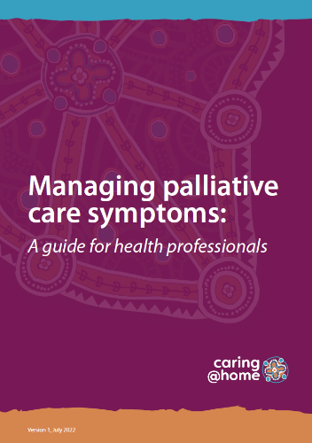
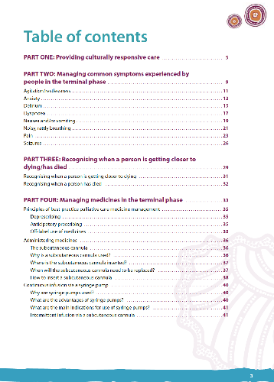
A guide for health professionals
Managing palliative care symptoms: A guide for health professionals
Notes:
Facilitator notes:
This guide is for primary care health professionals who are caring for Aboriginal and Torres Strait Islander families. It contains information to support palliative symptom management at home including supporting families to be part of this care.

Slide 14


caring@home apps
Easier access to caring@home resources
caring@home Indigenous app
caring@home app
The caring@home Indigenous app is free and supports health professionals providing palliative care to an Aboriginal and/or Torres Strait Islander person who has chosen to be cared for at home. It allows health professionals to:
Easily view
Download or print
Access tailored, best-practice, culturally appropriate resources.
The caring@home app assists health professionals supporting families and carers to help manage symptoms of a palliative care patient who chooses to be cared for, and die, at home if possible. It gives easy and quick access to resources for:
Carers, in English and nine other languages (including training videos)
Health professionals, and
Clinical services.

Slide 15
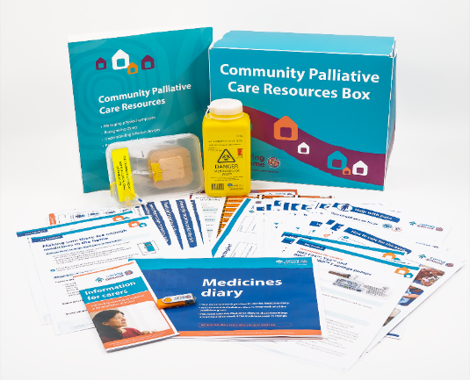
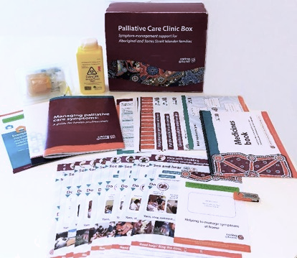
Resources for carers/ families
NEW Community Palliative Care Resources Box
Community Palliative Care Resources Box
Resources for culturally and linguistically diverse communities (CALD) in 9 languages
Resources for Aboriginal and Torres Strait Islander families packaged as the Palliative Care Clinic Box
Standard resources (only available via download from the website)
Palliative Care Clinic Box

Slide 16
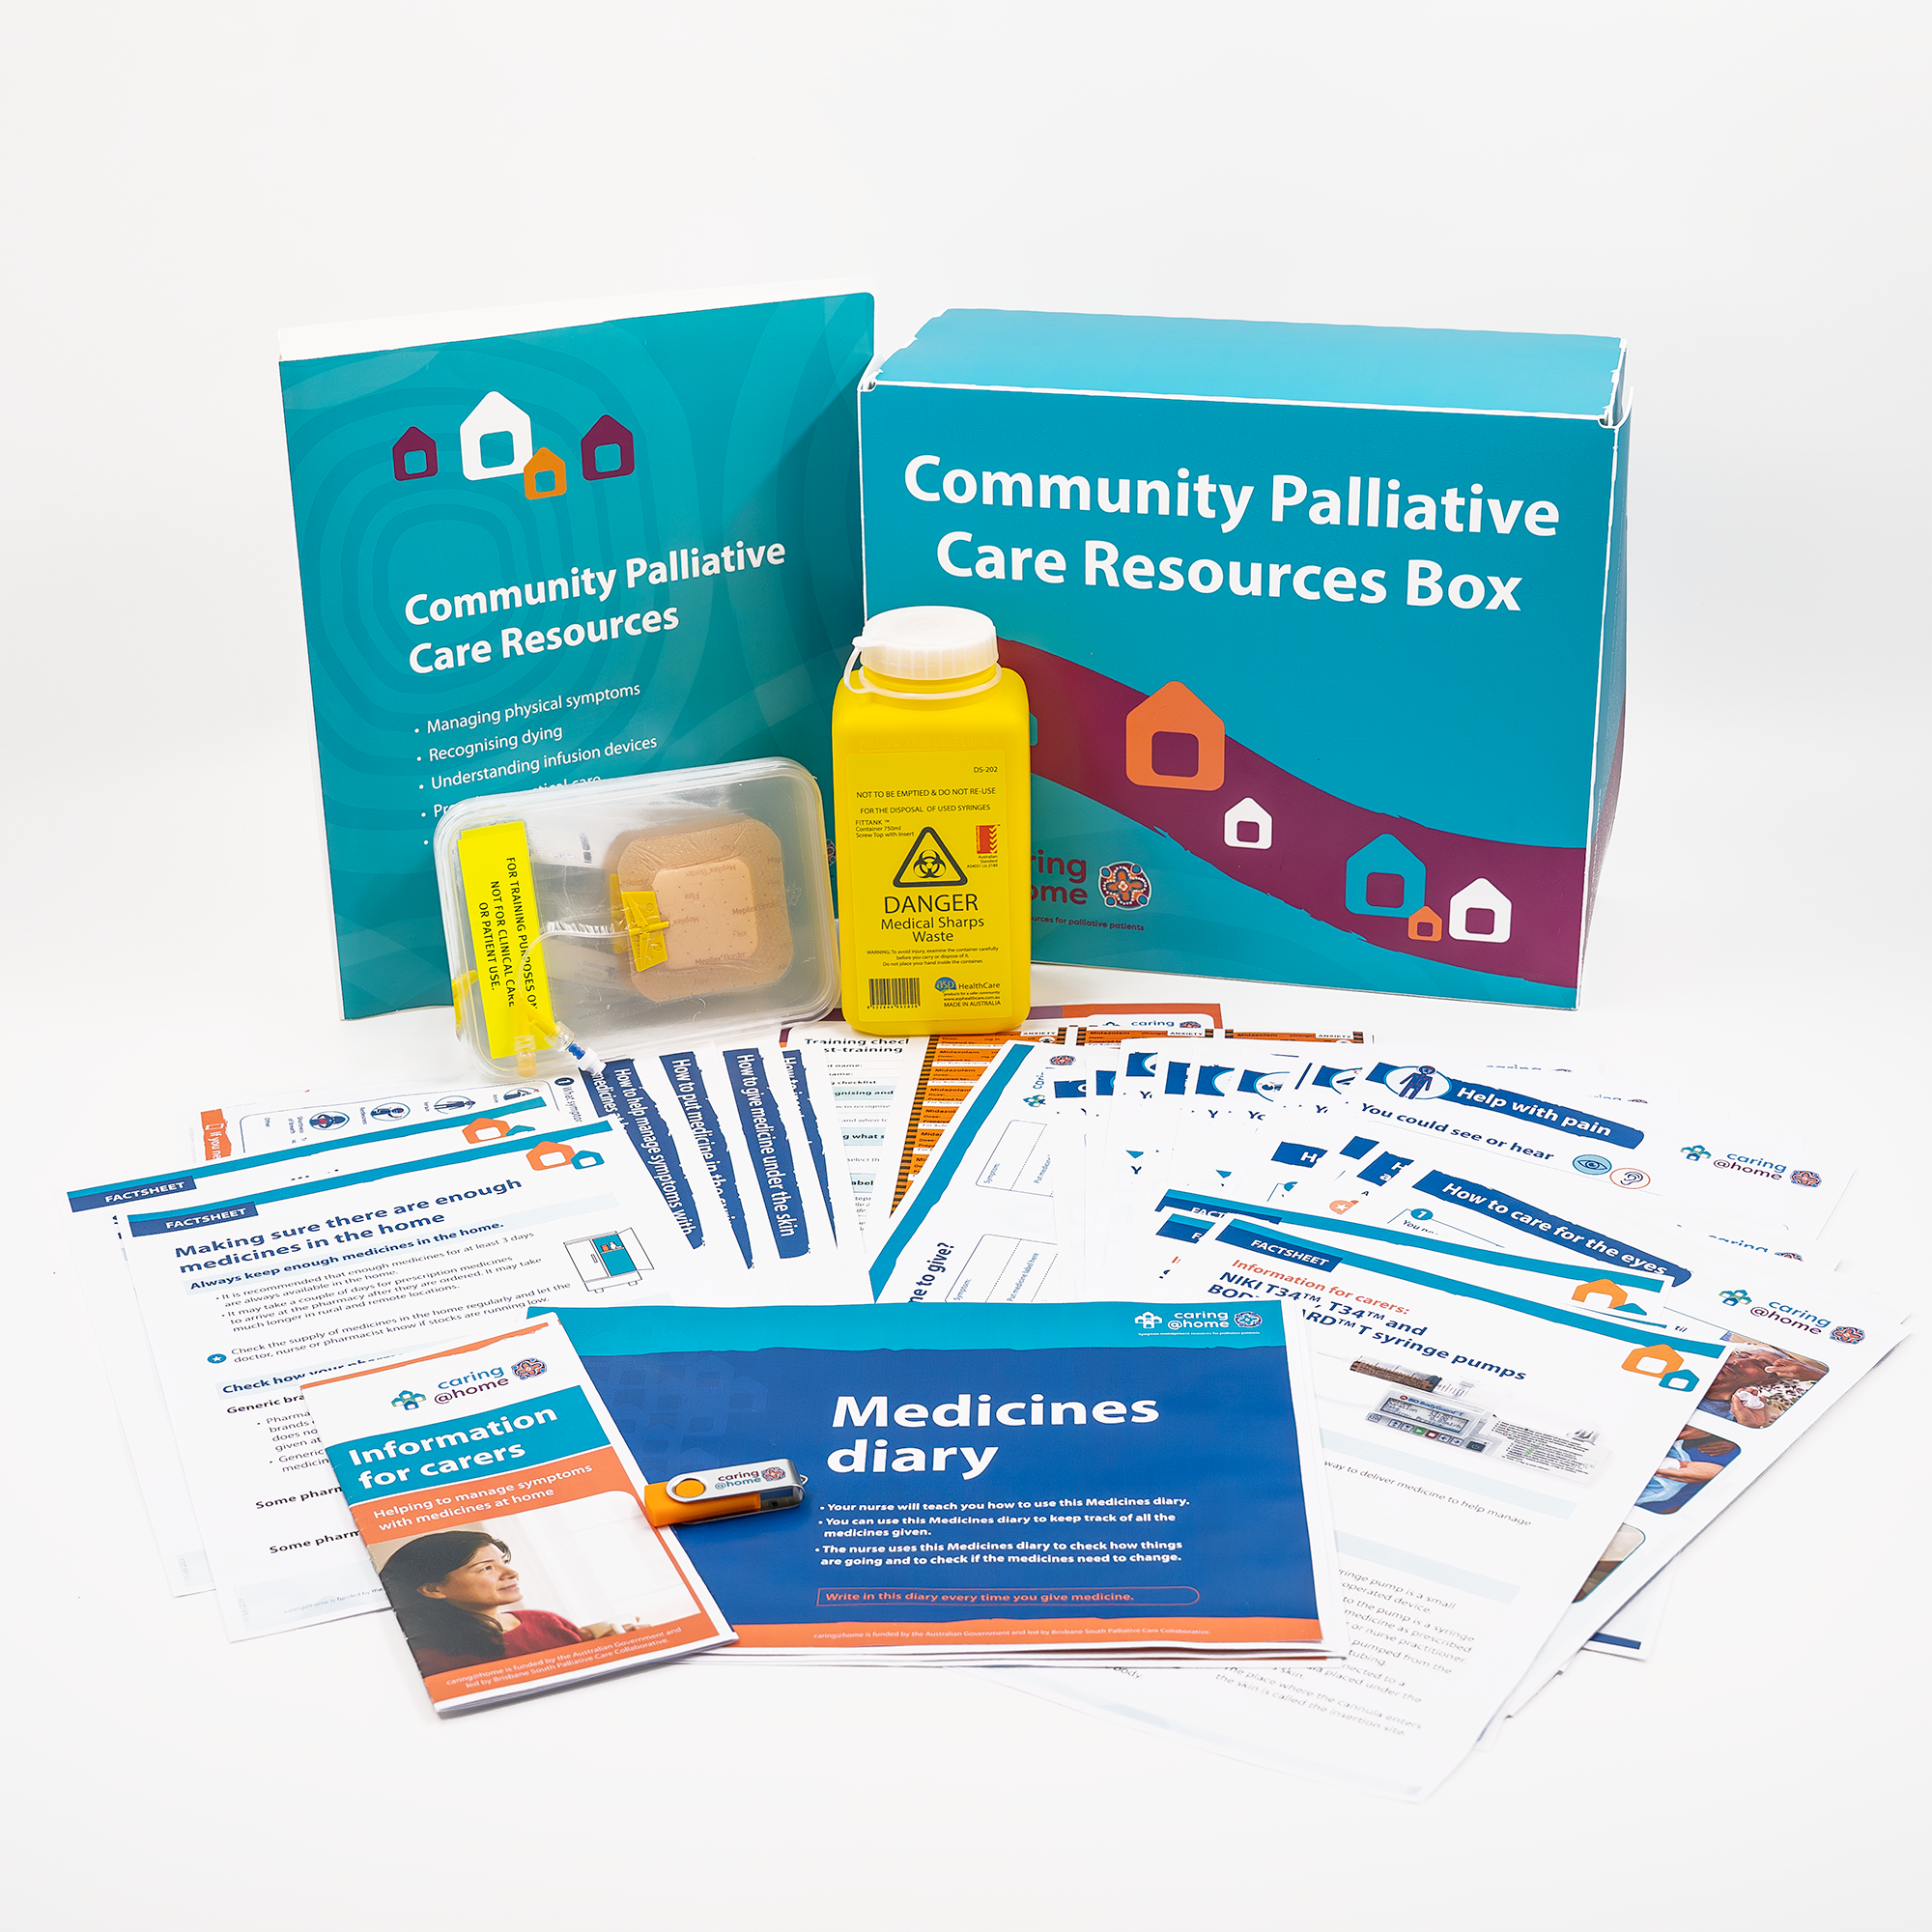
Community Palliative Care Resources Box
Practical demonstration kit
Syringe labels
Medicines diary
Managing Physical Symptoms Tip sheets
NEW Providing practical care Step-by-step guides
Training checklist
NEW Managing medicines in the home factsheets
Wall chart
Short training videos
NEW Understanding infusion devices Factsheets
Information brochure
Notes:
Notes:
Managing physical symptoms tip sheets:
Help with anxiety
Help with feeling sick and/or vomiting
Help with pain
Help with rattly breathing
Help with restlessness
Help with seizures
Help with shortness of breath
Help with troubling visions, sounds, thoughts
Common symptoms at end of life
Recognising dying:
Knowing when a person is getting closer to dying/Knowing when a person has died
Understanding infusion devices:
Information for carers: CADD™-SOLIS and CADD™-SOLIS VIP infusion pumps
Information for carers: NIKKI T34™, T34™ and BODYGUARD™T syringe pumps
Information for carers: Surefuser™+ infusion device
Providing practical care:
How to care for the eyes/How to care for the nose
How to care for the mouth
How to change a pad
How to position a person
How to wash a person
5. Managing subcutaneous medicines:
Helping to manage symptoms with medicines at home
Making sure there are enough medicines in the home
Storing your palliative care medicines safely/Disposing of your palliative care medicines safely
Practical handbook for carers
Medicines diary/book
Wall/fridge chart
Syringe labels
How to help manage symptoms with medicines at home
How to put medicine in the syringe
How to give medicine under the skin
How to insert a subcutaneous cannula
Training checklist and carer/family post-training competence assessment
​​
6. Practice demonstration kit​

Slide 17
Break

