Slide 1
Resources for carers
caring@home acknowledges the Traditional Custodians of country throughout Australia and their connections to land, sea and community. We pay our respect to their Elders past and present and extend that respect to all Aboriginal and Torres Strait Islander people.
caring@home for Aboriginal and Torres Strait Islander Families is funded by the Australian Government and led by Brisbane South Palliative Care Collaborative.

Slide 2
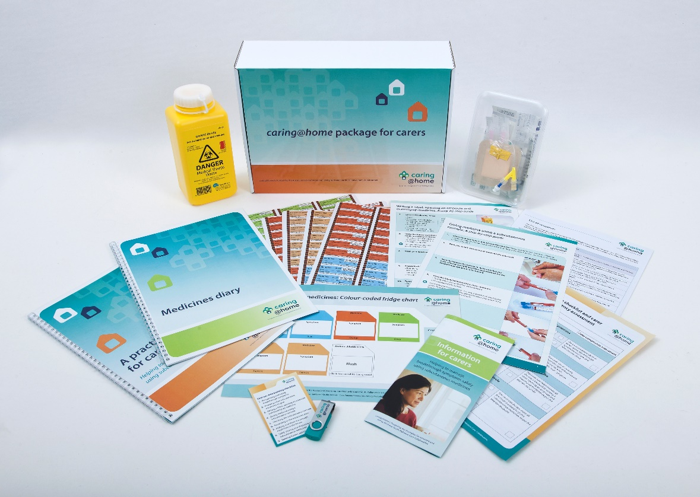
What is the caring@home package for carers
Supports health professionals to teach carers to manage breakthrough symptoms safely using subcutaneous medicines in a person who has chosen to be cared for, and die at home, if possible.
Developed after broad consultation with urban, rural and remote health professionals.
Supports individual learning styles (written, audio, visual, pictorial).
Easy to use.

Slide 3
What is contained in the caring@home package for carers?
For carers:
Practical handbook for carers
Writing a label, opening an ampoule and drawing up medicine - A step-by-step guide
Giving a medicine using a subcutaneous cannula - A step-by-step guide
Medicines diary - for carers to record all the subcutaneous medicines that are given
Symptoms and medicines: Colour-coded fridge chart
Short training videos (USB) - showing how to do each step when giving a subcutaneous medicine (5 videos)
A practice demonstration kit and sharps container
Information brochure for carers
For nurses
Syringe labels - The syringe labels are pre-printed and colour-coded.
One-on-one training checklist and carer post-training competency assessment

Slide 4
Example - Practical handbook for carers
The handbook provides written and pictorial material with all the information a carer needs to help manage breakthrough symptoms safely using subcutaneous medicines.

Slide 5
Example – Giving medicine using a subcutaneous cannula - A step-by-step guide

Slide 6
Practice demonstration kit for carers
The practice demonstration kit is used by a registered nurse as a teaching aid during a one-on-one training session. The carer can practise with the kit after the training.

Slide 7
Example - Medicines diary
The medicines diary is for carers to record all the subcutaneous
medicines that are given to the person being cared for.

Slide 8
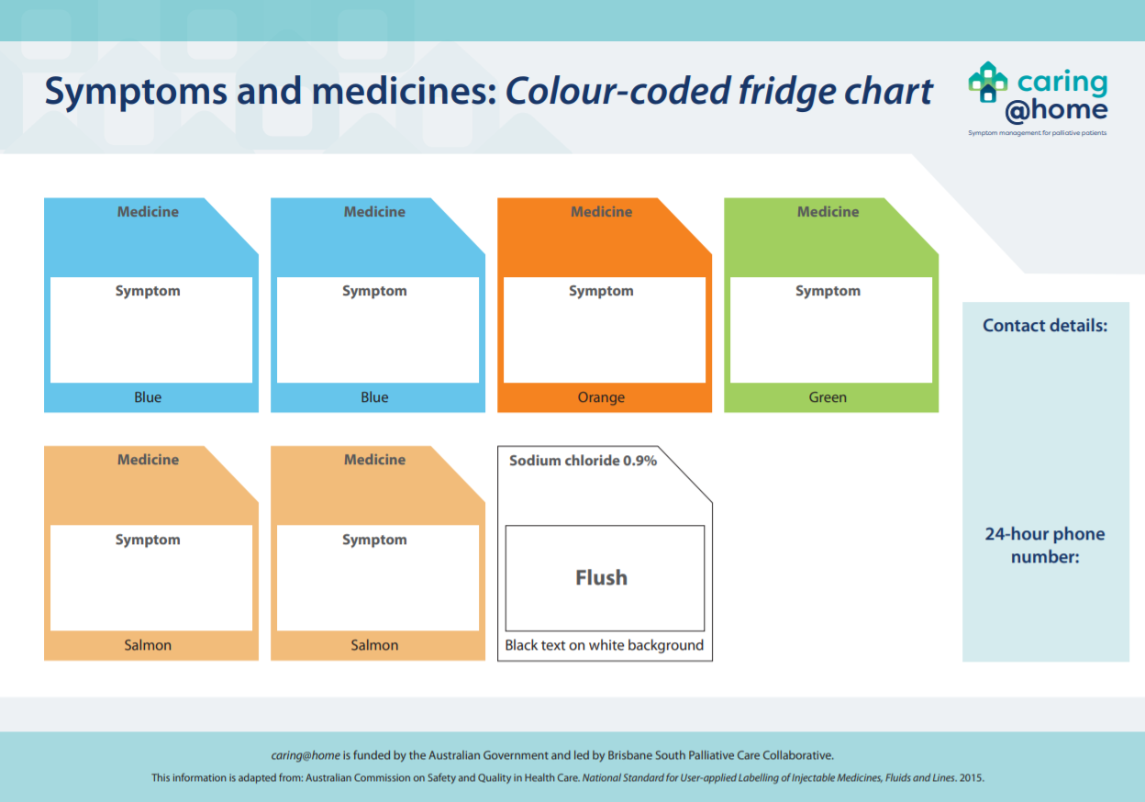
Example – Symptoms and medicines: Colour-coded fridge chart and syringe labels
The colour-coded labelling system - including the colour-coded fridge chart and syringe labels - acts as a safety check to ensure the correct medicine is given for each breakthrough symptom.
Example syringe labels

Slide 9
Example - One-on-one training checklist and carer post-training competency assessment
This checklist is used by the nurse to guide the one-on-one training session with the carer, and to check carer competency after the training session.

Slide 10
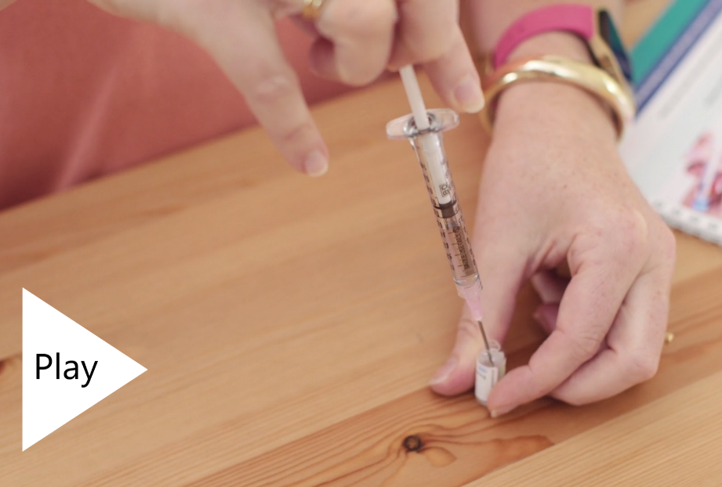
Example - Short training videos
The five training videos show how to do each step when giving a subcutaneous medicine.
Here are two examples of the videos.
Video 4 - caring@home: Writing a label, opening an ampoule and drawing up medicine
Video 5 - caring@home: Giving a medicine using a subcutaneous cannula

