Slide 1
Introducing caring@home resources
Presented by:
[Insert your name here]
[Insert your organisation here]
Notes:
Notes: ​
It is recommended that before you run this session with your team that you have: ​
Completed the online modules on the caring@home website​
Watched the short training videos​
Obtained and familiarised yourself with all the resources and how to access them​
Ensured that you have internet availability to demonstrate how to access the online modules for registered nurses.​
The resources include: ​
The caring@home package for carers (the package can be either ordered or most components downloaded from the caring@home website)
The Palliative Care Clinic Box ​(the package can be either ordered or most components downloaded from the caring@home website)
‘Guidelines for the handling of palliative care medicines in community services’​
The ‘Example policy and procedures: Supporting carers to help manage breakthrough symptoms safely using subcutaneous medicines in the home’​
A consensus-based list of medicines suitable for the management of terminal symptoms in community and residential aged care facilities in Australia ​
The palliMEDS app downloaded onto your phone

Slide 2
Presentation overview
caring@home project background
What resources are available, and for whom?
How will the resources help?

Slide 3
Why is caring@home important?
Notes:
Notes:
If you have the time in your session, you may wish to show this video.
The video is 2:35 minutes duration.
The link for the video is: https://www.caringathomeproject.com.au/tabid/6121/Default.aspx

Slide 4
What does the evidence teach us?
Many people wish to be cared for and die at home (1, 2)
Waiting for a professional to give breakthrough symptom medicines increases patient and carer distress (1, 2)
Poor symptom control often results in unwanted admission to an inpatient unit (3)
Carers feel empowered when taught to give subcutaneous medicines using high quality resources (4, 5, 6, 7, 8).

Slide 5
Carers’ comments
“We knew when the pain hit we were able to do something to try to relieve it immediately without having to sit waiting, powerless, for someone to come and do it. I believe it gave us confidence to keep him at home to the very end.” (8)
“These resources taught me and my mob how to yarn and feel good [about] giving medicine. I liked the one about worry because Aunty felt exactly like the picture.”​ - First Nations family in WA
“[caring@home resources] have helped us learn about how to give medicine at home when my loved one is experiencing pain…we now feel more comfortable giving medication to Uncle.” ​- First Nations family in VIC
“I really like the art with the pretty colours. I know it was made just for us mob. [I feel] safe now with these [resources].” – First Nations family in ACT

Slide 6
The caring@home resources
Suite of resources available for:
Clinical services
Health professionals
Carers/families
caringathomeproject.com.au
Notes:
Notes:
The resources are targeted at three levels:
Clinical services
Health professionals
Carers/families

Slide 7
Please note…
For patient safety, clinical services should only teach carers/families to use subcutaneous medicines if they can provide a 24-hour phone number, to provide appropriate clinical advice about managing subcutaneous medicines (1, 2).
Notes:
Notes:
Carers/families consistently indicate that having a telephone number that they can call at anytime for clinical advice is essential to help give them confidence to manage subcutaneous medicines.

Slide 8
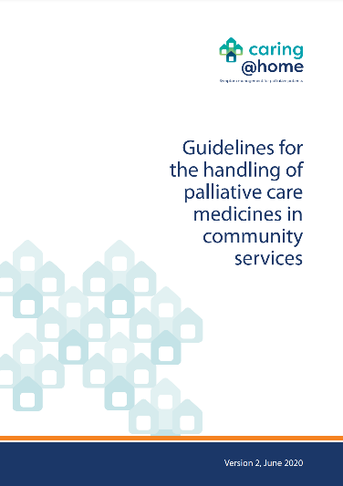
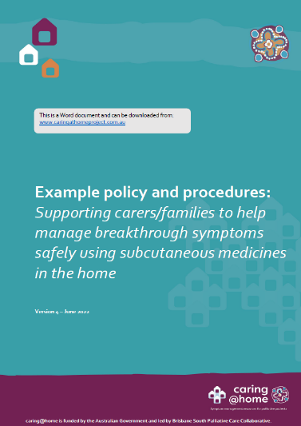
Resources for clinical services
Available for download
caringathomeproject.com.au
‘Guidelines for the handling of palliative care medicines in community services’ ​
‘Example policy and procedures: Supporting carers
to help manage breakthrough symptoms safely
using subcutaneous medicines in the home’​
Notes:
Notes:
The ‘Guidelines for the handling of palliative care medicines in community services (Version 2)’ were developed by the National Prescribing Service for the caring@home project.
These guidelines are important as they can be used by community service providers to inform the development of detailed protocols and procedures tailored to the requirements of individual services.
The ‘Example policy and procedures: Supporting carers to help manage breakthrough symptoms safely using subcutaneous medicines in the home (Version 4)’.
This document may be used by clinical services to develop and/or review relevant documentation within their own policies and procedures framework.

Slide 9
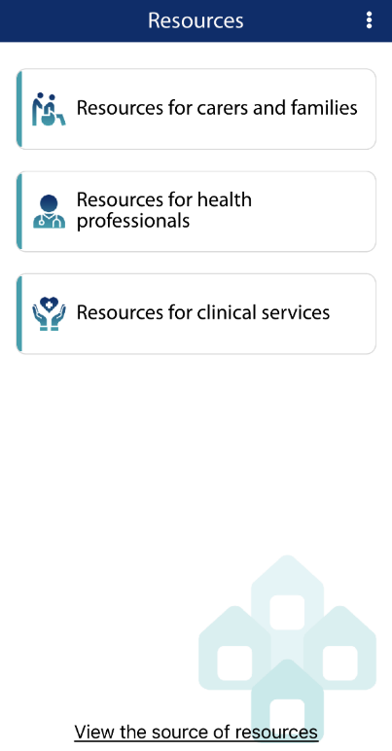
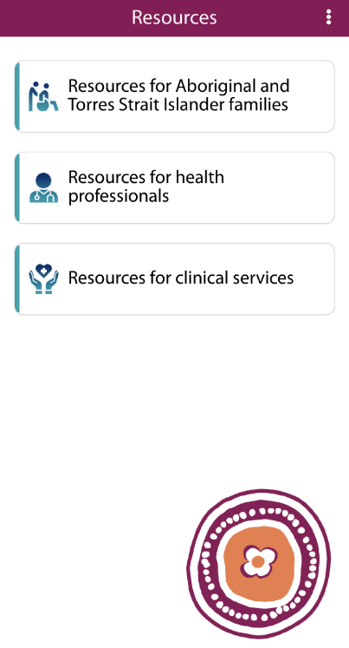
Health professionals
Online education modules
palliMEDS app
List of medicines to manage terminal symptoms in the community
A guide for health professionals providing palliative care to Aboriginal and Torres Strait Islander patients and their carers/families
caring@home app
caring@home Indigenous app

Slide 10
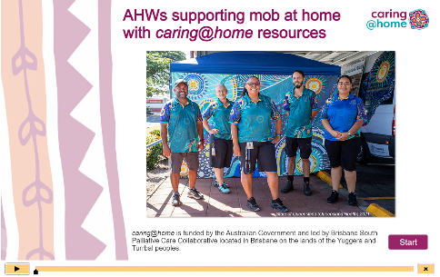
Online education modules
For Health Professionals
For Aboriginal Health Workers
Available to view
caringathomeproject.com.au
Notes:
Notes:
Online education modules for health professionals
It is recommended that health professionals complete all of the online modules prior to using the caring@home resources to teach carers/families to manage subcutaneous medicines at home.
Module 1 takes 20 minutes to complete. This module aims to educate health professionals about the caring@home resources.
Module 2 takes 40 minutes and is presented in two parts. This modules aims to educate health professionals about how to use the caring@home resources to teach carers to help manage breakthrough symptoms safely using subcutaneous medicines.
A certificate of learning can be printed for module 1 and each part of module 2.
Online education module for Aboriginal Health Workers
This module aims to educate AHWs about the caring@home resources.
This module takes 20 minutes to complete.
A certificate of learning can be generated on completion of the module.
These modules can be accessed through the caring@home website: https://www.caringathomeproject.com.au/tabid/5319/Default.aspx

Slide 11
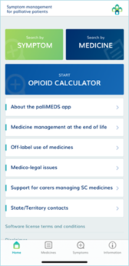
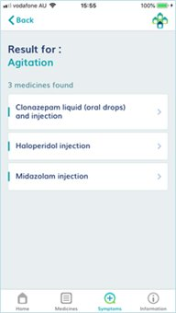
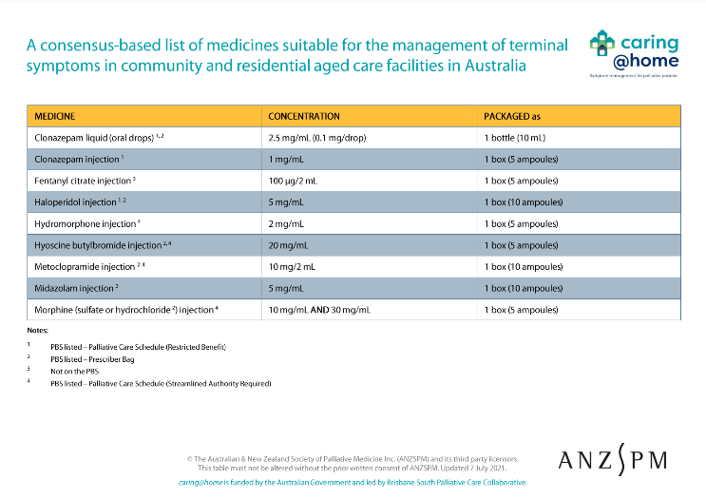
Medicines
palliMEDS app
‘Palliative care symptom management medicines for Australians living in the community’
Notes:
Notes: ​
The Palliative care symptom management medicines for Australians living in the community This is a consensus-based list of medicines suitable for use in the community for the management of terminal symptoms. The medicines have been endorsed by the Australian and New Zealand Society of Palliative Medicine and the target audience is generalists not specialists.
The palliMEDS app is available to download onto your phone.
This app explains the use of the eight medicines that have been endorsed for end-of-life care by the Australian and New Zealand Society of Palliative Medicine.

Slide 12
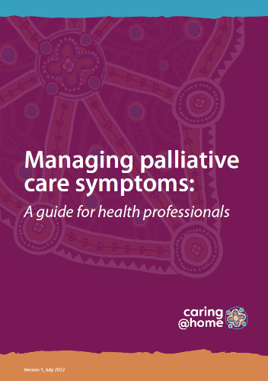
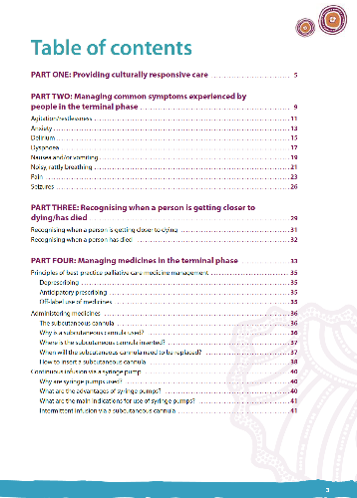
A guide for health professionals
Notes:
Notes:
This guide is for primary care health professionals who are caring for Aboriginal and Torres Strait Islander families. It contains information to support palliative symptom management at home including supporting families to be part of this care.

Slide 13
Apps
Easier access to caring@home resources
caring@home Indigenous app
The free caring@home Indigenous app supports health professionals providing palliative care to an Aboriginal and/or Torres Strait Islander person who has chosen to be cared for at home. The app enables health professionals to easily view, download or print the suite of tailored, best practice, culturally-appropriate caring@home resources for clinical services, health professionals, and Indigenous families and carers.
caring@home app
The caring@home app assists health professionals supporting families and carers to help manage symptoms of a palliative care patient who chooses to be cared for, and die, at home if possible. caring@home has designed a purpose-built app to give easy and quick access to resources for:
Carers, in English and nine other languages (including training videos)
Health professionals, and
Clinical services.

Slide 14
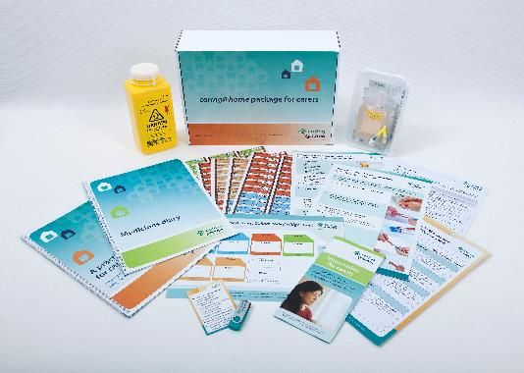
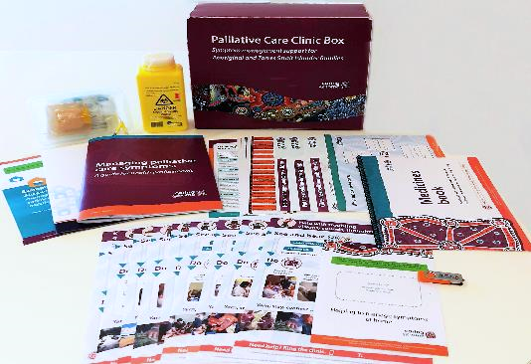
Resources for carers/families
Standard resources packaged as caring@home package for carers
Resources for culturally and linguistically diverse communities (CALD) in 9 languages
Resources for Aboriginal and Torres Strait Islander families packaged as the Palliative Care Clinic Box
Standard caring@home resource package
Palliative Care Clinic Box

Slide 15
Standard resources
Notes:
Notes:
A4 introductory brochure: This brochure introduces to carers to how they can help manage symptoms including safely using subcutaneous medicines. ​
Practical handbook for carers: The practical handbook provides written and pictorial material with the information a carer needs to help manage breakthrough symptoms safely using subcutaneous medicines. ​​This can be used as a teaching tool and/or as a reference for a carer. ​​The handbook itself is divided into 2 sections –(1) key information important for all carers and (2) extra information for those carers who like to read more. Some carers may not find the handbook useful and the videos can be used as an alternative. They have similar information presented in a way to meet different learning styles of carers. ​
Writing a label, opening an ampoule and drawing up medicine: A step-by-step guide​ The information in the laminated step-by-step guide is also in the practical handbook. ​This illustrated guide is a simple guide for carers to follow and explains how to write a syringe label correctly, open an ampoule and draw up medicine using a step-by-step approach. The step-by-step guide contains clear images and simple text to help the carer complete the tasks.​ ​You can use this to teach each individual step with a carer and later to check their competency to undertake each step. ​
Giving medicine using a subcutaneous cannula: A step-by-step guide​ ​The information in the laminated step-by-step guide is also in the practical handbook. ​This illustrated guide is a simple guide for carers to follow and explains how to give medicine using a subcutaneous cannula. The step-by-step guide contains clear images and simple text to help the carer complete the tasks.​ ​You can use this to teach each individual step with a carer and later to check their competency to undertake each step. ​
Medicines diary​ The medicines diary is for carers to record all the subcutaneous medicines that are given. Details to be entered include date, time, name of medicine, reason for giving medicine and symptom rating before and about 20 minutes after medicine is given. ​The diary allows the health care team to monitor the medicines given and assess if medicines need to be changed. It also promotes communication between the carer and the health care team.​ ​​
Colour-coded labelling system​ The colour-coded labelling system includes medicine labels for syringes and the Symptoms and medicines: Colour-coded fridge chart. Medicine labels​: The medicine labels are colour-coded and pre-printed with the name of the medicine and the symptom that is treated by that medicine. All syringes containing subcutaneous medicines must be labelled correctly by the person who draws up the medicine (RN or carer): the dose (from the medicine order), the volume in the syringe, the date drawn up and the initials of the person drawing up the medicine. ​ ​ Fridge chart​: Before giving any subcutaneous medicine the label on the syringe should always be checked carefully to make sure the right medicine is selected.​ ​The fridge chart acts as an additional check to help the carer select the correct medicine for a particular breakthrough symptom. Nurses can write on the chart each medicine and the name of the symptom it is used to treat. The colour-coding matches the colour coding on the medicine labels.​
Practice demonstration kit​ The practice demonstration kit can be used by nurses as a teaching aid during the one-on-one training session and by carers to practice giving medicines through a subcutaneous cannula during and after the training session. ​ ​The practice demonstration kit consists of a disposal plastic box with a subcutaneous cannula inserted into a stoma-type adhesive dressing on the lid of the box. The dressing mimics a person’s skin. The other equipment in the plastic box includes blunt drawing-up needles, glass and plastic ampoules, syringes (1mL and 3mL) and syringe caps.​
Short training videos​ The 5 videos can be use as a teaching tool and left in the house as a reference for carers. Carers who are visual learners or who do not have strong literacy skills will find these particularly useful. They have similar information to that in the practical handbook.​

Slide 16
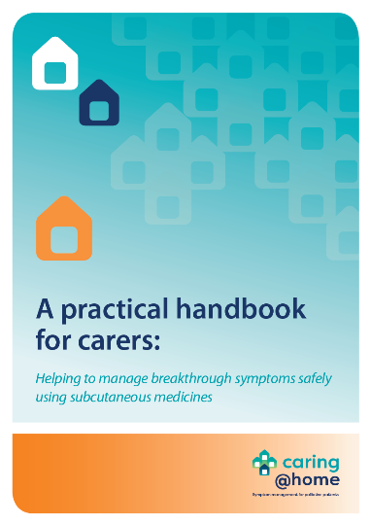
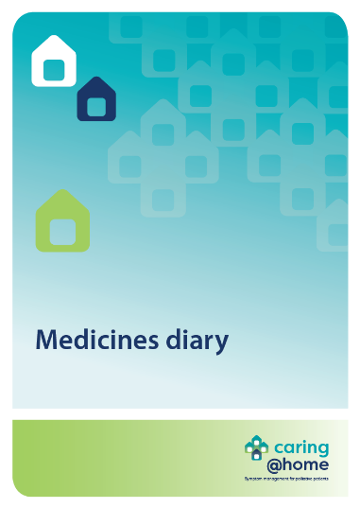
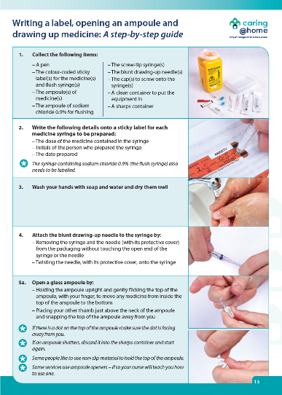
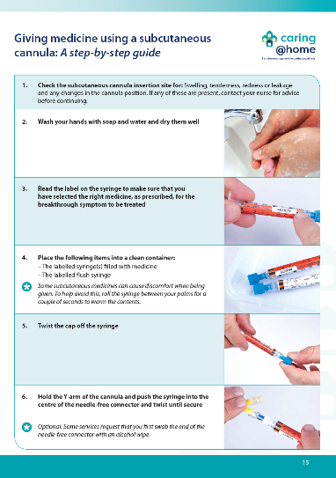
Standard resources
Practical handbook
Medicines diary
Step-by-step guide
Step-by-step guide
Notes:
Notes:
The handbook provides written information and pictures that the carer may need to help manage breakthrough symptoms safely using subcutaneous medicines.
The medicines diary is used to record all the subcutaneous medicines that the carer gives to the person they are caring for.
The two illustrated guides explain to the carer, using a step-by-step approach, how to:
- Write a label, open an ampoule and draw up medicine
- Give medicine using a subcutaneous cannula.

Slide 17
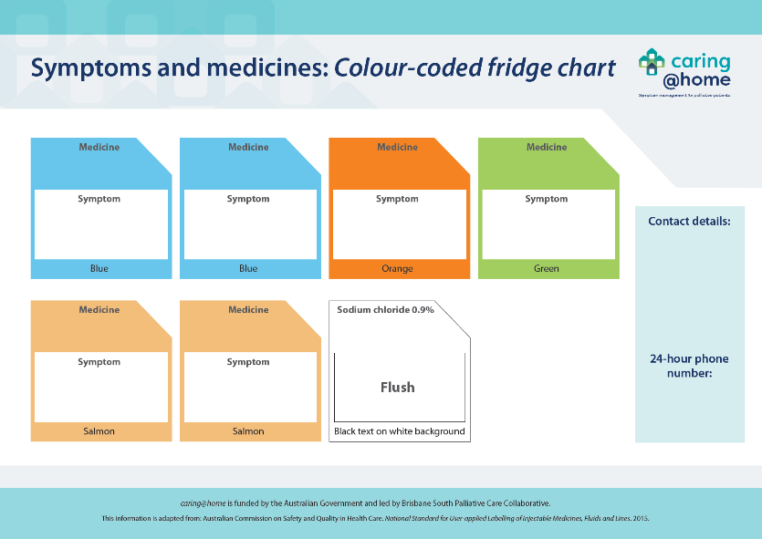
Colour-coded labelling system
Syringe labels
Fridge chart
Notes:
Notes:
The colour-coded labelling system acts as an extra safety check for the carer to help them select the correct medicine for each breakthrough symptom. It includes:
Colour-coded sticky labels for syringes and
Symptoms and medicines: Colour-coded fridge chart
The colour-coded labelling system is adapted from: Australian Commission on Safety and Quality in Health Care. National Standards for User-applied Labelling of Injectable Medicines, Fluids and Lines. 2015.
The nurse must always reiterate to the carer that the most important thing is to check the label on the syringe. This is an important part of the competency check.

Slide 18
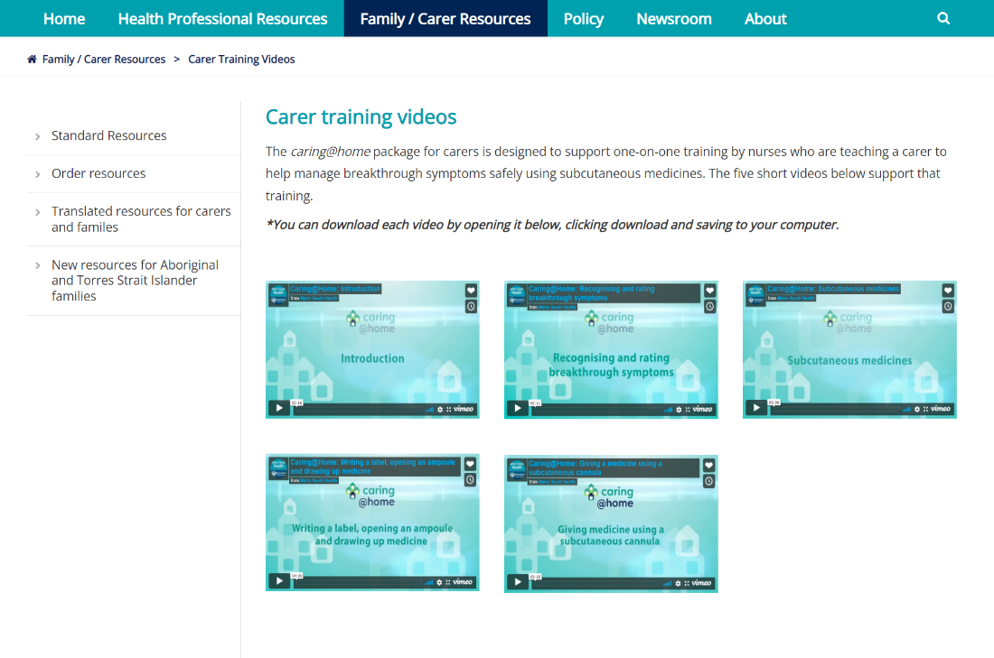
Carer training videos
Available to watch
caringathomeproject.com.au

Slide 19
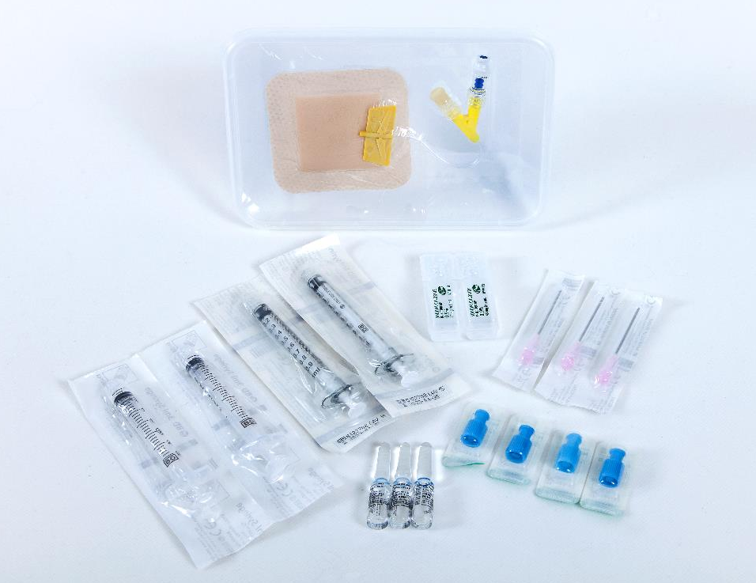
Practice demonstration kit
Notes:
Notes:
The practice demonstration kit can be used by the nurse as a teaching tool and by the carer as a practice device.

Slide 20
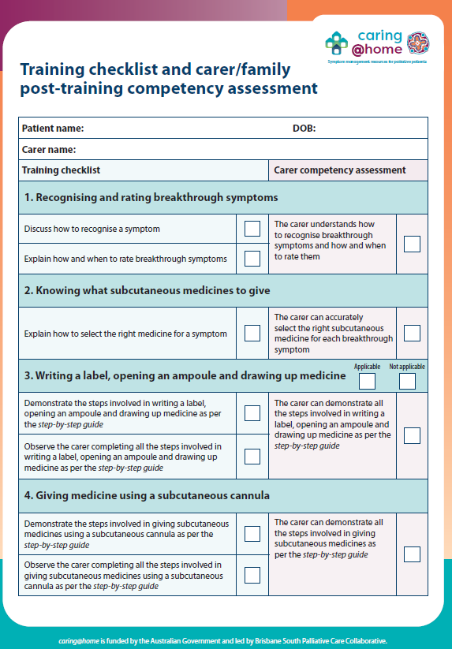
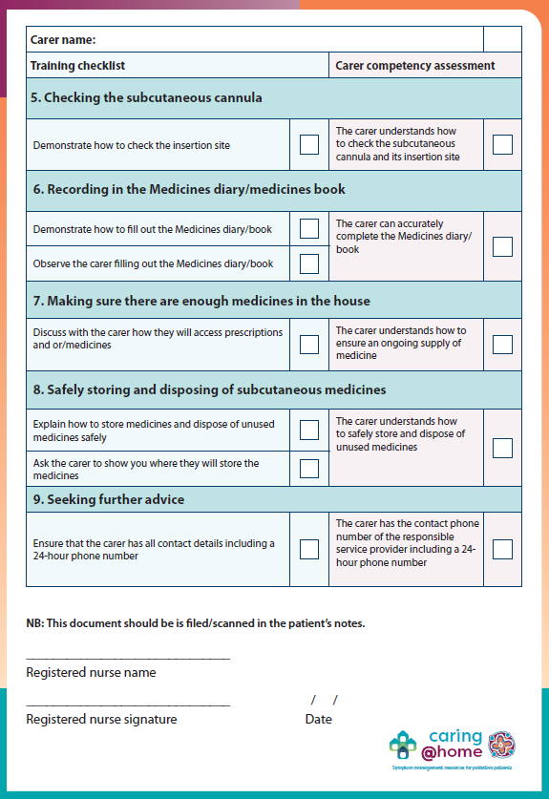
Training checklist
Dual purpose checklist for RNs for the training session/s with carer/family member
The competency assessment should be included in patient’s notes
Notes:
Notes:​
There are 9 key elements to the one-on-one training session conducted by RNs and outlined in the checklist. ​
The one-on-one training checklist and carer post training competency assessment form has a dual purpose:
A teaching tool for RNs to guide the one-on-one training session​
Prompts for the RN to ensure that the carer is competent with each element. ​
The form may be stored in the patient’s notes. ​

Slide 21
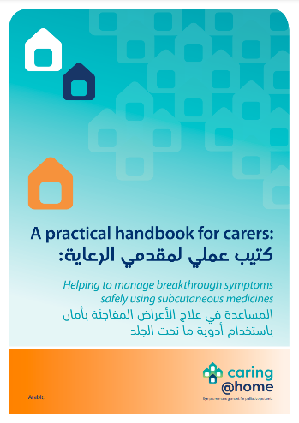
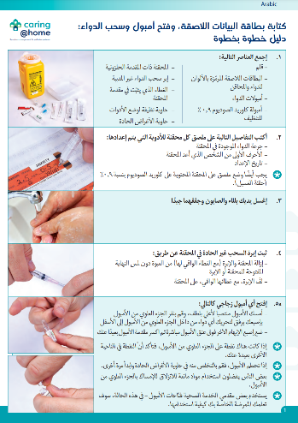
Translated resources
Practical handbook
Step-by-step guide
The key resources of carers/families are available in 9 commonly spoken languages in Australia: Arabic, Greek, Hindi, Italian, Punjabi, Simplified Chinese, Traditional Chinese, Tagalog, Vietnamese.
The resources that have been translated are:
A4 introductory brochure
Practical handbook for carers
Writing a label, opening an ampoule and drawing up medicine: A step-by-step guide​
Giving medicine using a subcutaneous cannula: A step-by-step guide​
Medicines diary
Fridge chart
Short training videos

Slide 22
Resources for Aboriginal and Torres Strait Islander families
Introductory brochure
Tip sheets
Step-by-step guides
Medicines book
Wall chart
Syringe labels
A practice demonstration kit
Short training videos
Palliative Care Clinic Box
(contains resources for three families)

Slide 23
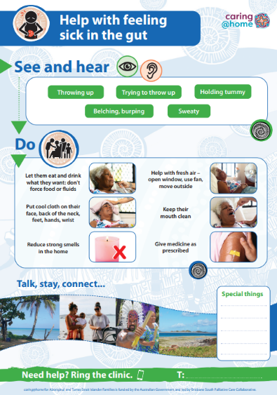
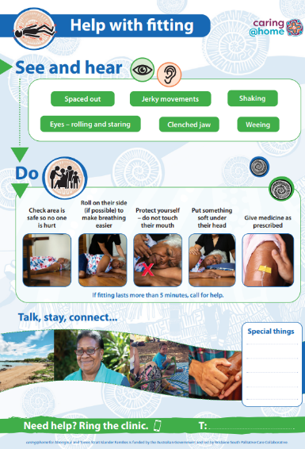
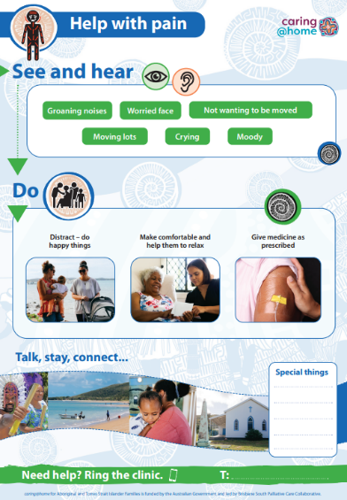
Please note…
Several of these resources have been produce with Torres Strait Islander specific artwork including:
Introductory brochure
Tip sheets
Step-by-step guides
Medicines book
Wall chart

Slide 24
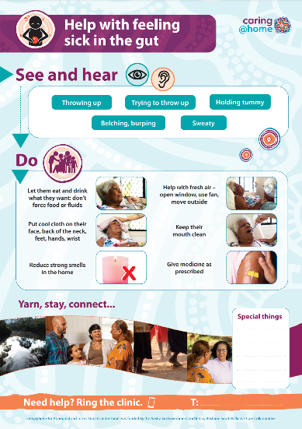
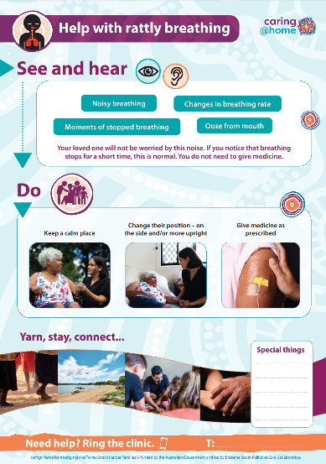
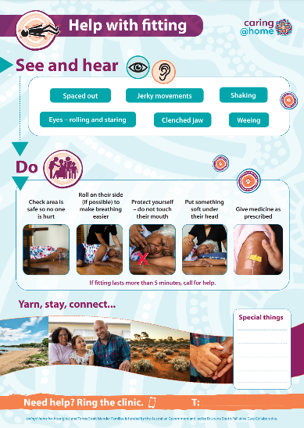
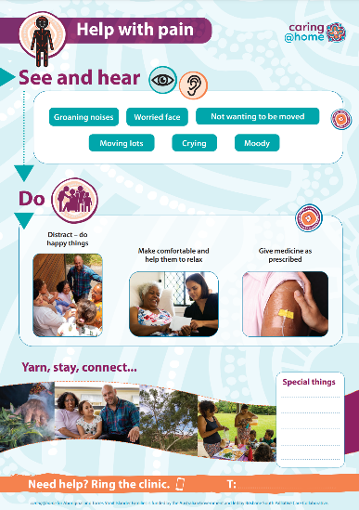
Tip sheets
Notes:
Notes:
The tip sheets provide written and pictorial information about how to identify a symptom and what actions can be taken to help the person being cared for.

Slide 25
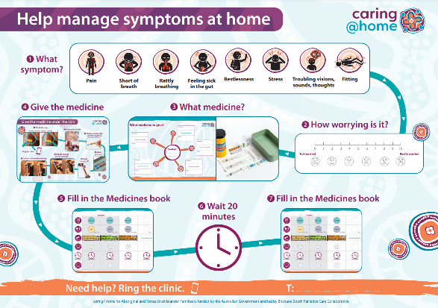
Step-by-step guides
Notes:
Notes:
Help manage symptoms at home: This illustrated guide explains how to manage symptoms at home by giving medicine.
Put the medicine in the syringe: This illustrated guide explains how to label a syringe correctly, open an ampoule and draw up medicine using a step-by-step approach.
Give the medicine under the skin: This illustrated guide explains how to give medicine through a subcutaneous cannula using a step-by-step approach.

Slide 26
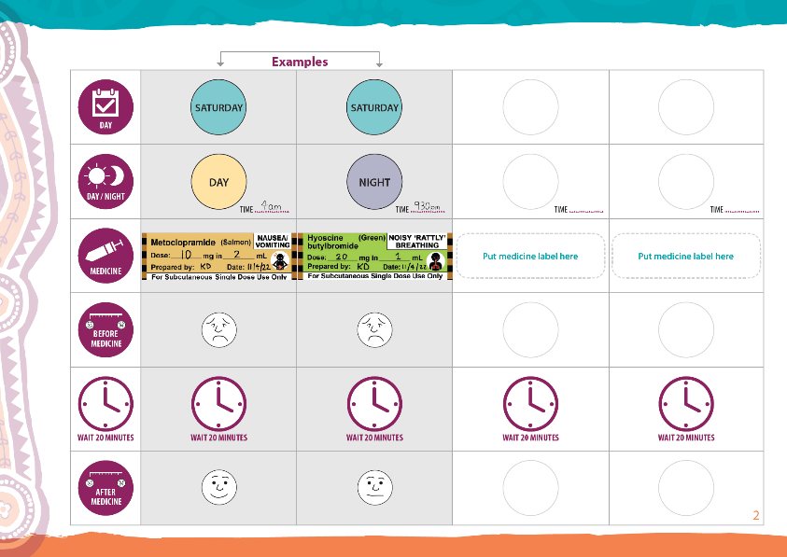
Medicines book
Notes:
Notes:
The medicines book is for families to record all the subcutaneous medicines that are given.

Slide 27
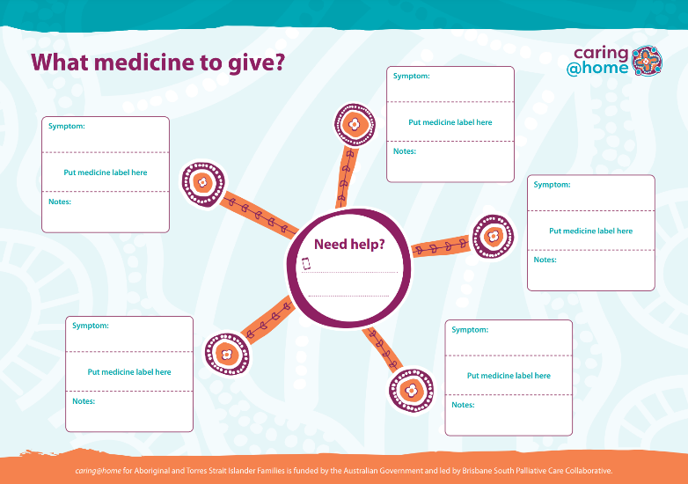
Colour-coded labelling system
Syringe labels
Fridge chart
Notes:
Notes:
The colour-coded labelling system acts as an extra safety check for the carer/family to help them select the correct medicine for each breakthrough symptom. It includes:
Colour-coded sticky labels for syringes and
A wall chart
The colour-coded labelling system is adapted from: Australian Commission on Safety and Quality in Health Care. National Standards for User-applied Labelling of Injectable Medicines, Fluids and Lines. 2015.
The nurse must always reiterate to the carer/family that the most important thing is to check the label on the syringe. This is an important part of the competency check.

Slide 28
Short training videos for carers
Available to watch
caringathomeproject.com.au
Notes:
Notes:
The videos show how to do each step when giving subcutaneous medicine.
The videos support carers’ different learning styles.

Slide 29
Short training videos for carers with voiceover
Creole (Torres Strait)
Eastside Kriol (NT)
Kriol (WA)
Martu (WA)
Murrinh Patha (NT)
Ngaanyatjarra (NT)
Pitjanjatjara (NT)
Warlpiri (NT)
Yolngu Matha (NT)
Available to watch
caringathomeproject.com.au
Notes:
Notes:
The videos show how to do each step when giving subcutaneous medicine.
The videos support carers’ different learning styles.

Slide 30
Feedback
“I am just emailing you to say that I received six carers' packages from caring@home last week. Our healthcare staff have expressed how comprehensive and useful these packs appear to be.
Yesterday my colleague used a package with a family who took their mum home for a home death and the feedback from the family was great. They were able to go through the information and practise overnight with the equipment supplied, whilst their mum remained in hospital.
My colleague returned to the ward this morning and the family were able to demonstrate how to do everything on the (competency) checklist you provided. In summary, this is an amazing resource for patients, carers and nurses."
Palliative Care CNC, NSW

Slide 31
So let’s chat…
Notes:
Notes:
Now that you have provided an overview of the caring@home resources, their uses and benefits, take time to generate a robust discussion with the leadership group that you are presenting to.
It may be helpful to consider the following questions to prompt discussion:
- What concerns, if any, do you have?
- What barriers do you think might impact implementation?
- What enablers can you identify?
- What processes do you envisage engaging in to embed the resources into your practice? ie will you need to develop workplace policy around this?
- How will you educate your workforce?

Slide 32
References
Swerissen H, Duckett S. Dying well. Grattan Institute. 2014. Available from: https://grattan.edu.au/wp-content/uploads/2014/09/815-dying-well.pdf [Accessed 3 December 2018].​
Productivity Commission. Introducing Competition and Informed User Choice to Human Services: Reforms to Human Services, Report No. 85, Canberra; 2017. Available from: https://www.pc.gov.au/inquiries/completed/human-services/reforms/report/human-services-reforms.pdf [Accessed 6 December 2018].​
Rosenberg JP, Bullen T, Maher K. Supporting family caregivers with palliative symptom management: A qualitative analysis of the provision of an emergency medication kit in the home setting. Am J Hosp Palliat Care. 2015; 32(5): 484-489. Available from: https://doi.org/10.1177%2F1049909114531326. [Accessed 6 December 2018].​
Shepperd S, Gonçalves-Bradley DC, Straus S, Wee B. Hospital at Home: home-based end-of-life care. Cochrane Database Syst. Rev. 2016; 2: 1465-1858. Available from: https://doi.org/10.1002/14651858.CD009231.pub2. [Accessed 6 December 2018].​
Latter S, Hopkinson JB, Lowson E, et al. Supporting carers to manage pain medication in cancer patients at the end of life: A feasibility trial. Palliat Med. 2018; 32(1): 246-256. Available from: https://doi.org/10.1177/0269216317715197. [Accessed 6 December 2018].​

Slide 33
References
Payne S, Turner M, Seamark D, et al. Managing end of life medications at home – accounts of bereaved family carers: a qualitative interview study. BMJ Support Palliat Care. 2015; 5: 181-188. Available from: http://dx.doi.org/10.1136/bmjspcare-2014-000658. [Accessed 6 December 2018].​
Healy S, Israel F, Charles M, Reymond L. Laycarers can confidently prepare and administer subcutaneous injections for palliative care patients at home: A randomized controlled trial. Palliat Med. 2018; 32(7): 1208-1215. Available from: https://doi.org/10.1177%2F0269216318773878. [Accessed 6 December 2018].​
Israel F, Reymond L, Slade G, Menadue S, Charles MA. Lay caregivers’ perspectives on injecting subcutaneous medications at home. Int J Palliat Nurs. 2008; 14(8): 390-395. Available from: https://doi.org/10.12968/ijpn.2008.14.8.30774. [Accessed 6 December 2018].​

