Slide 1
Introducing caring@home resources
Presented by:
[Insert your name here]
[Insert your organisation here]
Notes:
Notes:
It is recommended that before you run this session with your team that you have:
Completed the online modules for nurses on the caring@home website
Watched the 5 short carer training videos
Obtained and familiarised yourself with all the resources and how to access them
Ensured that you have internet availability to demonstrate how to access the online modules for registered nurses.
The resources include:
The caring@home package for carers (the package can be either ordered or most components downloaded from the caring@home website)
‘Guidelines for the handling of palliative care medicines in community services’
The ‘Example policy and procedures: Supporting carers to help manage breakthrough symptoms safely using subcutaneous medicines in the home’
The Palliative care symptom management medicines for Australians living in the community (Refer to the RN lanyard card)
The palliMEDS app downloaded onto your phone.

Slide 2
Presentation overview
caring@home : The background
What resources are available, for whom?
How will the resources help?

Slide 3
caring@home consortium members
caring@home is funded by the Australian Government and led by the Brisbane South Palliative Care Collaborative
Notes:
Notes:
caring@home is funded by the Australian Government, delivered through a Consortium of 8 key national bodies and led by the Brisbane South Palliative Care Collaborative.
It is one of the National palliative care projects.

Slide 4
Why is caring@home important?
Notes:
Notes:
If you have the time in your session, you may wish to show this video.
The caring@home introductory video is 3:17 minutes duration.
The link for the video is: https://www.caringathomeproject.com.au/tabid/4877/Default.aspx

Slide 5
What does the evidence teach us?
Many people wish to be cared for and die at home (1, 2)
Waiting for a professional to give breakthrough symptom medicine increases patient and carer distress (1, 2)
Poor symptom control often results in unwanted admission to hospital (3)
Carers feel empowered when taught to give subcutaneous medicines using high quality resources (4, 5, 6, 7,8).

Slide 6
Carer’s comment
“We knew when the pain hit we were able to do something to try
to relieve it immediately without having to sit waiting, powerless,
for someone to come and do it.
I believe it gave us confidence to keep him at home to the very end” (8)

Slide 7
caring@home resources
The website: www.caringathomeproject.com.au
Suite of resources available for:
Community service providers
Healthcare professionals
General practitioners, nurse practitioners, registered nurses and pharmacists
Carers
Notes:
Notes:
The resources are targeted at three levels:
Organisational
Healthcare professionals
Carers.

Slide 8
Please note….
For patient safety, the caring@home resources must be used only by services that provide, or otherwise have access to, a 24-hour oncall phone number for carers, to provide appropriate clinical advice about managing subcutaneous medicines (4, 9).

Slide 9
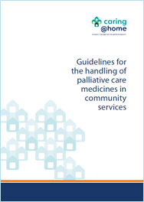
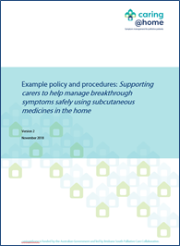
Resources for community service providers
‘Guidelines for the handling of palliative care medicines in community services’ Developed by the National Prescribing Service (NPS) for caring@home
‘Example policy and procedures: Supporting carers to help manage breakthrough symptoms safely using subcutaneous medicines in the home’
Available for download
www.caringathomeproject.com.au
Notes:
Notes:
The ‘Guidelines for the handling of palliative care medicines in community services’ were developed by the National Prescribing Service for the caring@home project.
These guidelines are important as they can be used by community service providers to inform the development of detailed protocols and procedures tailored to the requirements of individual services.
The ‘Example policy and procedures: Supporting carers to help manage breakthrough symptoms safely using subcutaneous medicines in the home’.
This document may be used by community service providers to develop and/or review relevant documentation within their own policies and procedures framework.

Slide 10
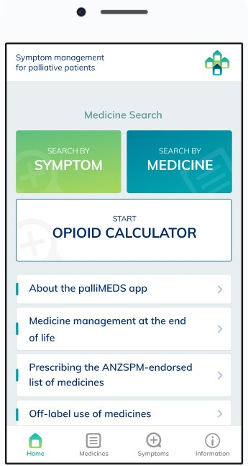
Resources for healthcare professionals
Palliative care symptom management medicines for Australians living in the community and in Residential Aged Care Facilities (RACFs)
palliMEDS app – now with handy opioid calculator
Notes:
Notes:
The Palliative care symptom management medicines for Australians living in the community
This is a consensus-based list of medicines suitable for use in the community for the management of terminal symptoms. The medicines have been endorsed by the Australian and New Zealand Society of Palliative Medicine and the target audience is generalists not specialists.
2. The palliMEDS app is available to download onto your phone.
This app has been designed by NPS MedicineWise for caring@home and explains the use of the eight medicines that have been endorsed for end-of-life care by the Australian and New Zealand Society of Palliative Medicine.

Slide 11
Online modules for RNs
The online modules aim to educate RNs about how to use the caring@home resources to teach carers to manage breakthrough symptoms safely using subcutaneous medicines.
Notes:
Notes:
It is recommended that each nurse completes the online modules prior to using the caring@home resources.
Module 1 takes 20 minutes to complete.
Module 2 takes 40 minutes and is presented in two parts.
A certificate of learning can be printed for module 1 and each part of module 2.
The online modules aim to educate RNs about how to use the caring@home resources to teach carers to help manage breakthrough symptoms safely using subcutaneous medicines.
RNs have the option to participate in a pre/post survey as part of the evaluation component of the caring@home project. This is voluntary.
These modules can be accessed through the caring@home website: https://www.caringathomeproject.com.au/tabid/5319/Default.aspx

Slide 12
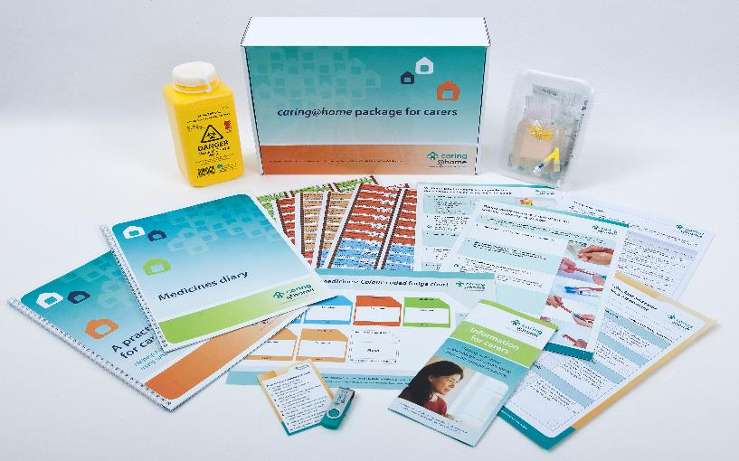
caring@home package for carers
The most important part of the caring@home package for carers is the one-on-one training session with a nurse
The nurse uses the package to teach carers how to help manage breakthrough symptoms safely using subcutaneous medicines.

Slide 13
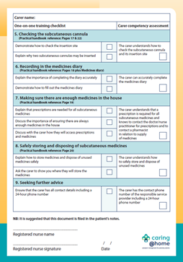
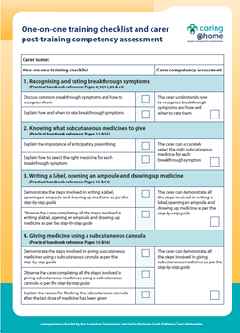
Checklist for RNs
Dual purpose checklist for RNs for the
one-on-one training session with a carer
Notes:
Notes:
There are 9 key elements to the one-on-one training session conducted by RNs and outlined in the checklist.
The one-on-one training checklist and carer post training competency assessment form has a dual purpose:
- A teaching tool for RNs to guide the one-on-one training session
- Prompts for the RN to ensure that the carer is competent with each element.
The form may be stored in the patient’s notes.

Slide 14
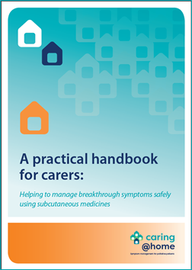
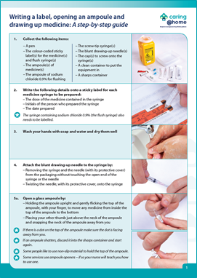
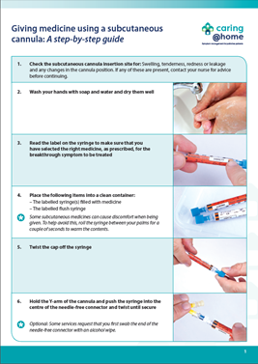
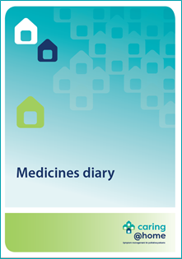
Handbook, diary, step-by-step guides
Notes:
Notes:
The handbook provides written information and pictures that the carer may need to help manage breakthrough symptoms safely using subcutaneous medicines.
The medicines diary is used to record all the subcutaneous medicines that the carer gives to the person they are caring for.
The two illustrated guides explain to the carer, using a step-by-step approach, how to:
- Write a label, open an ampoule and draw up medicine
- Give medicine using a subcutaneous cannula.

Slide 15
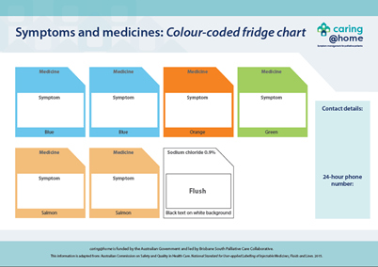
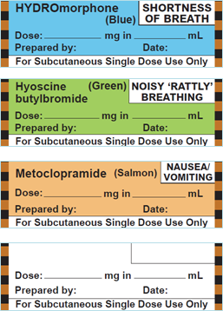
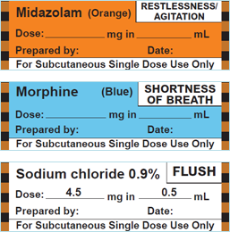
Colour-coded labelling system
Syringe labels
Notes:
Notes:
The colour-coded labelling system acts as an extra safety check for the carer to help them select the correct medicine for each breakthrough symptom. It includes:
Colour-coded sticky labels for syringes and
Symptoms and medicines: Colour-coded fridge chart
The colour-coded labelling system is adapted from: Australian Commission on Safety and Quality in Health Care. National Standards for User-applied Labelling of Injectable Medicines, Fluids and Lines. 2015.
The nurse must always reiterate to the carer that the most important thing is to check the label on the syringe. This is an important part of the competency check.

Slide 16
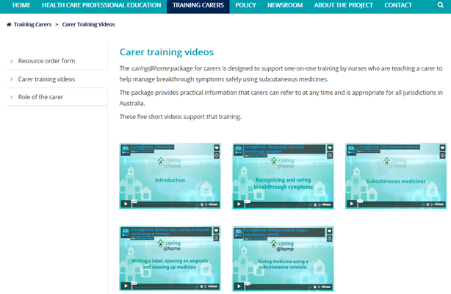
Short training videos for carers
Notes:
Notes:
The videos:
- Show the carer how to help manage breakthrough symptoms using subcutaneous medicines
- Support carers’ different learning styles.

Slide 17
Practice demonstration kit
Notes:
Notes:
The practice demonstration kit can be used by the nurse as a teaching tool and by the carer as a practice device.

Slide 18
Champion feedback
“I am just emailing you to say that I received six carers' packages from caring@home last week. Our healthcare staff have expressed how comprehensive and useful these packs appear to be.
Yesterday my colleague used a package with a family who took their mum home for a home death and the feedback from the family was great. They were able to go through the information and practise overnight with the equipment supplied, whilst their mum remained in hospital. My colleague returned to the ward this morning and the family were able to demonstrate how to do everything on the (competency) checklist you provided.
In summary, this is an amazing resource for patients, carers and nurses."
Palliative care CNC, NSW

Slide 19
So let’s chat…..
Notes:
Notes:
Now that you have provided an overview of the caring@home resources, their uses and benefits, take time to generate a robust discussion with the leadership group that you are presenting to.
It may be helpful to consider the following questions to prompt discussion:
- What concerns, if any, do you have?
- What barriers do you think might impact implementation?
- What enablers can you identify?
- What processes do you envisage engaging in to embed the resources into your practice? ie will you need to develop workplace policy around this?
- How will you educate your whole nursing workforce?

Slide 20
References
Swerissen H, Duckett S. Dying well. Grattan Institute. 2014. Available from: https://grattan.edu.au/wp-content/uploads/2014/09/815-dying-well.pdf [Accessed 3 December 2018].
Productivity Commission. Introducing Competition and Informed User Choice to Human Services: Reforms to Human Services, Report No. 85, Canberra; 2017. Available from: https://www.pc.gov.au/inquiries/completed/human-services/reforms/report/human-services-reforms.pdf [Accessed 6 December 2018].
Rosenberg JP, Bullen T, Maher K. Supporting family caregivers with palliative symptom management: A qualitative analysis of the provision of an emergency medication kit in the home setting. Am J Hosp Palliat Care. 2015; 32(5): 484-489. Available from: https://doi.org/10.1177%2F1049909114531326. [Accessed 6 December 2018].
Shepperd S, Gonçalves-Bradley DC, Straus S, Wee B. Hospital at Home: home-based end-of-life care. Cochrane Database Syst. Rev. 2016; 2: 1465-1858. Available from: https://doi.org/10.1002/14651858.CD009231.pub2. [Accessed 6 December 2018].
Latter S, Hopkinson JB, Lowson E, et al. Supporting carers to manage pain medication in cancer patients at the end of life: A feasibility trial. Palliat Med. 2018; 32(1): 246-256. Available from: https://doi.org/10.1177/0269216317715197. [Accessed 6 December 2018].

Slide 21
References
Payne S, Turner M, Seamark D, et al. Managing end of life medications at home – accounts of bereaved family carers: a qualitative interview study. BMJ Support Palliat Care. 2015; 5: 181-188. Available from: http://dx.doi.org/10.1136/bmjspcare-2014-000658. [Accessed 6 December 2018].
Healy S, Israel F, Charles M, Reymond L. Laycarers can confidently prepare and administer subcutaneous injections for palliative care patients at home: A randomized controlled trial. Palliat Med. 2018; 32(7): 1208-1215. Available from: https://doi.org/10.1177%2F0269216318773878. [Accessed 6 December 2018].
Israel F, Reymond L, Slade G, Menadue S, Charles MA. Lay caregivers’ perspectives on injecting subcutaneous medications at home. Int J Palliat Nurs. 2008; 14(8): 390-395. Available from: https://doi.org/10.12968/ijpn.2008.14.8.30774. [Accessed 6 December 2018].
Wilson E, Caswell G, Turner N, Pollock K. Managing medicines for patients dying at home: A review of family caregivers’ experiences. J Pain Symptom Manage. 2018; 56(6):962-974. Available from: https://doi.org/10.1016/j.jpainsymman.2018.08.019. [Accessed 6 December 2018].

Slide 22
w: www.caringathomeproject.com.au
t: 1300 600 007
e: caringathome@health.qld.gov.au

